Slide 1
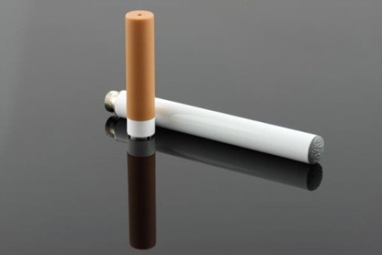
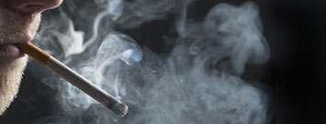
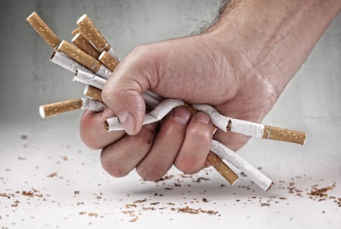
Smoking and HIV: What Clinicians Need to Know
[Trainer Name]
[Training Date]
[Training Location]
Notes:
The purpose of this introductory training is to provide HIV clinicians (including, but not limited to physicians, dentists, nurses, and other allied medical staff, therapists and social workers, and counselors, specialists, and case managers) with a detailed overview of smoking, the relationship between smoking and HIV/AIDS, and effective behavioral and medical smoking cessation approaches. The duration of the training is approximately 120-150 minutes (2-2 ½ hours), depending on whether the trainer chooses to present all of the slides, or a selection of slides.
Pre- and post-test questions have been inserted at the beginning and end of the presentation to assess a change in the audience’s level knowledge after the information has been presented. An answer key is provided in the Trainer’s notes for slides 5-9 and slides 108-112. Additional “test your knowledge” content questions and “what do you think” opinion questions have been woven throughout the presentation, as well.
Audience Response System can be utilized, if available, when facilitating the pre- and post-test question sessions.
In addition, a case study and companion video has been included on slides 84-85 to encourage dialogue among the training participants, and to illustrate how the information presented can be used clinically.
Image Credits (Left to Right): CDC website, 2016; CDC website, 2016; Fotolia, 2016 (purchased image); Fotolia, 2016 (purchased image); Fotolia, 2016 (purchased image).

Slide 2
Training Collaborators
LA Region Pacific AIDS Education and Training Center
Pacific Southwest Addiction Technology Transfer Center
UCLA Integrated Substance Abuse Programs
Notes:
This PowerPoint presentation, Trainer Guide, and companion fact sheet were developed by Beth Rutkowski, MPH (Associate Director of Training of UCLA ISAP) and Thomas E. Freese, PhD (Director of Training of UCLA ISAP and Principal Investigator/Director of the Pacific Southwest ATTC) through supplemental funding provided by the Pacific AIDS Education and Training Center, based at Charles R. Drew University of Medicine and Science. We wish to acknowledge Phil Meyer, LCSW, Kevin-Paul Johnson, Maya Gil Cantu, MPH, and Thomas Donohoe, MBA, from the LA Region PAETC.

Slide 3
Special Acknowledgements
Kimberlee Homer Vagadori, MPH, California Youth Advocacy Network
Steven A. Schroeder, MD, University of California, San Francisco
Notes:
The authors wish to thank the individuals featured on the slide for their valuable contributions to this curriculum.

Slide 4
Test Your Knowledge
Notes:
INSTRUCTIONS
The purpose of the following five (5) questions is to test the pre-training level of smoking and HIV knowledge amongst the training participants. The questions are formatted as either multiple choice or true/false questions. Read each question and the possible responses aloud, and give training participants time to jot down their response before moving on to the next question. Do not reveal the answers to the questions until the end of the training session (when you re-administer the questions that appear on slides 108-112).

Slide 5
Pre-Test Question
1. How fast does nicotine reach the smoker’s brain?
3 seconds
5 seconds
10 seconds
30 seconds
More than 1 minute
Notes:
ANSWER KEY
#1 – correct response is C (10 seconds)

Slide 6
Pre-Test Question
2. On average, every cigarette takes _____ minutes off of your life.
1 minute
5 minutes
7 minutes
11 minutes
22 minutes
Notes:
ANSWER KEY
#2 – correct response is D (11 minutes)

Slide 7
Pre-Test Question
3. What percentage of smokers start smoking in their teens?
15%
30%
50%
70%
80% or more
Notes:
ANSWER KEY
#3 – correct response is E (80% or more)

Slide 8
Pre-Test Question
4. Using tobacco products may affect HIV in which of the following ways:
Less successful HIV drug therapy
More likely to experience side effects of HIV medications
Higher CD4 counts
Lesser chance of developing opportunistic infections
Higher rates of HIV transmission
A, B, and E only
All of the above
Notes:
ANSWER KEY
#4 – correct response is F (A, B, and E only)

Slide 9
Pre-Test Question
5. How many classes of FDA-approved smoking cessation medications are available?
None
1
3
5
More than 10
Notes:
ANSWER KEY
#5 – correct response is C (3)

Slide 10
Introductions
Briefly tell us:
What is your name?
Where do you work and what do you do there?
Who is your favorite musician or performer?
What is one reason you decided to attend this training session?
Notes:
INSTRUCTIONS
In an effort to break the ice and encourage group interaction, take a few minutes to ask training participants to briefly share the answers to these four questions. You can ask for several volunteers to share their responses, if the size of your audience prevents all participants from sharing.
If the group is too large for formal introductions, the trainer can quickly ask participants the following two questions to gauge their work setting and professional training:
1. How many [case managers, LMFTs or LCSWs, counselors, administrators, physicians, PAs, nurse practitioners, nurses, medical assistants, dentists, etc.] are in the room? Did I miss anyone? {elicit responses}
2. How many people work in a [substance abuse, mental health, primary care, infectious disease] setting? Did I miss any settings? {elicit responses}

Slide 11
Educational Objectives
At the end of this training session, participants will be able to:
List and describe at least four types of smoked and smokeless tobacco products
Review trends in the prevalence of smoking among adolescents and adults in the United States
Discuss the impact of smoking and tobacco use on HIV disease
Describe at least three evidence-based behavioral or medical smoking cessation interventions
Notes:
INSTRUCTIONS
Briefly review each of the educational objectives with the audience.

Slide 12
Why are we Talking about Smoking?
Smoking remains the leading cause of preventable death and disease in the United States, killing more than 480,000 Americans each year
SOURCE: CDC, 2016.
Notes:
Smoking remains the leading cause of preventable death and disease in the United States, killing more than 480,000 Americans each year (in other words, smoking is responsible for nearly 1 out of every 5 deaths). Smoking can cause immediate damage to your body, harms every organ system, and leads to disease and disability. For every smoking-related death, at least 30 Americans live with a smoking-related illness. The only proven strategy to protect yourself from harm is to never smoke, and if you do smoke or use tobacco products, to quit.
The Centers for Disease Control and Prevention have numerous smoking and tobacco use resources, including a smoking cessation campaign called “Tips from Former Smokers.” For more information, visit: http://www.cdc.gov/tobacco.

Slide 13
Did You Know?
Nicotine reaches your brain within 10 seconds
Research shows menthols may be even more addictive than other cigarettes
More than 7,000 chemicals are found in a single puff of cigarette smoke
Notes:
**ANIMATION INSTRUCTIONS**
The first of three text box animations will appear automatically. Click once to advance to the 2nd animation, and click again to advance to the 3rd animation. Once the 3rd animation appears, click one more time to advance to the next slide.
REFERENCE: National Institute on Drug Abuse. (2014). Tobacco/Nicotine Webpage. Accessed May 27, 2016 from https://www.drugabuse.gov/drugs-abuse/tobacco-nicotine.

Slide 14
Did You Know?
Nearly 9 out of 10 adult smokers started before they were 18
3 out of 4 teen smokers who think they will stop smoking in a few years won’t
Some teens have cravings after just a few cigarettes
Notes:
**ANIMATION INSTRUCTIONS**
The first of three text box animations will appear automatically. Click once to advance to the 2nd animation, and click again to advance to the 3rd animation. Once the 3rd animation appears, click one more time to advance to the next slide.
REFERENCE: National Institute on Drug Abuse. (2014). Tobacco/Nicotine Webpage. Accessed May 27, 2016 from https://www.drugabuse.gov/drugs-abuse/tobacco-nicotine.

Slide 15
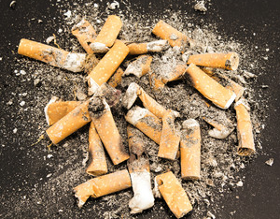
Did You Know?
A pack-a-day smoker spends about $2,000 per year on cigarettes
Cigarette butts are the #1 littered item on US roads
Notes:
**ANIMATION INSTRUCTIONS**
The first of two text box animations will appear automatically. Click once to advance to the 2nd animation. Once the 2nd animation appears, click one more time to advance to the next slide.
REFERENCE: National Institute on Drug Abuse. (2014). Tobacco/Nicotine Webpage. Accessed May 27, 2016 from https://www.drugabuse.gov/drugs-abuse/tobacco-nicotine.

Slide 16
Did You Know?
On average, every cigarette takes 11 minutes off of your life
In the US, more than 1,200 people die each day due to smoking
On average, smokers die 10 years younger than non-smokers
Notes:
**ANIMATION INSTRUCTIONS**
The first of three text box animations will appear automatically. Click once to advance to the 2nd animation, and click again to advance to the 3rd animation. Once the 3rd animation appears, click one more time to advance to the next slide.
REFERENCE: National Institute on Drug Abuse. (2014). Tobacco/Nicotine Webpage. Accessed May 27, 2016 from https://www.drugabuse.gov/drugs-abuse/tobacco-nicotine.

Slide 17
Did You Know?
Natural. Filtered. No additives.
It Doesn’t Matter!!
There is no safe cigarette
Notes:
**ANIMATION INSTRUCTIONS**
The stop sign animation will appear automatically. You do not need to click in order to make the animation appear.
REFERENCE: National Institute on Drug Abuse. (2014). Tobacco/Nicotine Webpage. Accessed May 27, 2016 from https://www.drugabuse.gov/drugs-abuse/tobacco-nicotine.

Slide 18
What’s the Link between Smoking and HIV?
The prevalence of smoking among people living with HIV remains 2- to 3-fold higher than that of the general population, and this high prevalence of smoking has profound health implications for HIV-positive individuals
SOURCE: Rahmanian et al., 2011..
Notes:
The prevalence of cigarette smoking among individuals living with HIV infection is exceedingly high, and tobacco has been implicated as a major contributor in the increase of smoking-related illnesses, such as cardiovascular disease, respiratory illnesses, and cancers. Research shows that if you are infected with HIV, the harmful effects of smoking are greatly magnified, even when HIV appears to be under control through the use of antiretroviral medications.
REFERENCE:
Rahmanian, S., Wewers, M.E., Koletar, S., Reynolds, N., Ferketich, A., & Diaz, P. (2011). Cigarette smoking in the HIV-infected population. Proceedings of the American Thoracic Society, 8(3), 313-319.

Slide 19
Types of Tobacco Products
What are we talking about?
Notes:
TRANSITION SLIDE
This next section of the presentation reviews, in detail, the various types of tobacco products that are used in the United States, and beyond.
Image Credit: Fotolia, 2016 (purchased image).

Slide 20
Where is Tobacco Grown?
In 2015, five countries—China, Brazil, India, Turkey, and the United States—produced two-thirds of the world’s tobacco.
Grown in 16 states in the US.
The largest tobacco-producing states are Kentucky and North Carolina (account for 71% of all tobacco grown in US)
SOURCE: World Lung Foundation, 2015.
Notes:
Nicotine is a leafy plan grown around the world. It is grown in more than 125 countries, though 5 countries produce two-thirds of all tobacco. Tobacco is grown on a wide variety of soil and climates. The production of tobacco leaves has more than doubled since the 1960s.
REFERENCE:
World Lung Foundation. (2015). The Tobacco Atlas. Accessed June 2, 2016 from http://www.tobaccoatlas.org.
Image Credit: WHO, 2016.

Slide 21
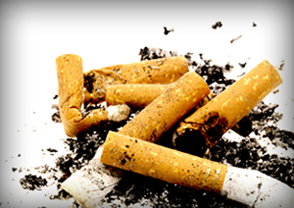
How can Dried Tobacco Leaves be Used?
Shredded and smoked in cigarettes, cigars, and pipes
Ground into snuff, which is sniffed through the nose
Cured and made into chewing tobacco
Moistened, ground or shredded into dip, which is placed in the mouth between the lip and gum
SOURCE: US DHHS, 2016.
Notes:
Nicotine is a leafy plan grown around the world. Dried tobacco leaves can be used in a variety of ways.
REFERENCE:
US Department of Health and Human Services. (2016). Tobacco and Nicotine. Accessed May 27, 2016 from http://betobaccofree.hhs.gov/about-tobacco/tobacco-and-nicotine/index.html.
Image Credit: NIDA website, 2016.

Slide 22
Test Your Knowledge
How many ingredients are contained within a cigarette?
50
150
250
500
600+
Notes:
ANSWER KEY
The correct response is E (600+)

Slide 23
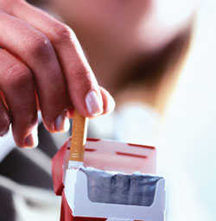
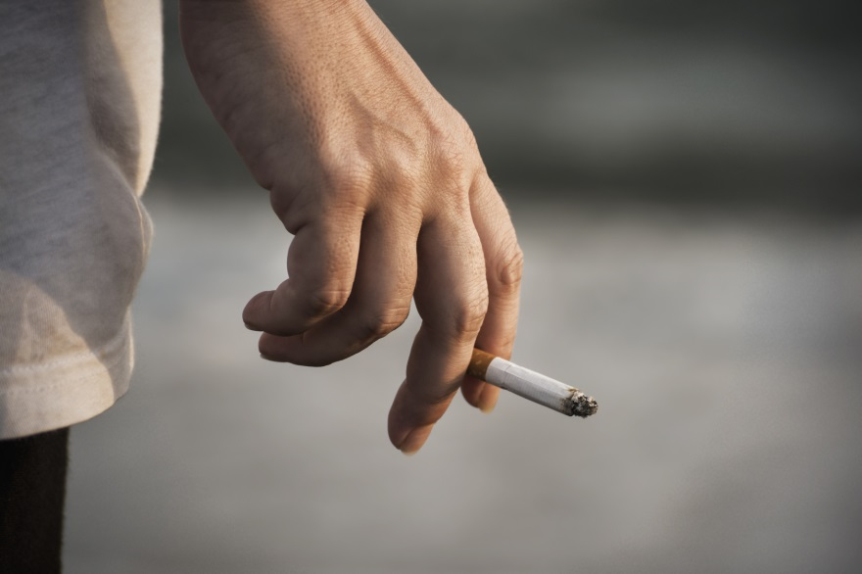
Cigarettes
Small cylinder of finely cut tobacco leaves rolled in thin paper for smoking
Contain approximately 600 ingredients
When burned, create more than 7,000 chemicals
At least 69 are known to cause cancer
Many of the chemicals are poisonous
Warning labels do not exist to warn public of for toxins in tobacco smoke
SOURCE: American Lung Association, 2016.
Notes:
A cigarette is a small cylinder of finely cut tobacco leaves rolled in thin paper for smoking. The cigarette is ignited at one end and allowed to smolder; its smoke is inhaled from the other end, which is held in or to the mouth. In some cases, a cigarette holder may be used, as well. Most modern manufactured cigarettes are filtered and also include reconstituted tobacco and other additives. The term cigarette, as commonly used, refers to a tobacco cigarette, but can apply to similar devices containing other substances, such as cannabis. A cigarette is distinguished from a cigar by its smaller size, use of processed leaf, and paper wrapping, which is normally white, though other colors and flavors are also available. Cigarettes contain approximately 600 ingredients. When burned, they create upwards of 7,000 chemicals, many of which are known to cause cancer or are poisonous. Many of the chemicals found in cigarette smoke are also found in consumer products, but those products carry warning labels. No such warning exists to warn the public of the toxins that are contained in cigarette smoke.
The following list details a few of the chemicals in tobacco smoke and other places they are found:
Acetone – found in nail polish remover
Acetic Acid – an ingredient in hair dye
Ammonia – a common household cleaner
Arsenic – used in rat poison
Benzene – found in rubber cement
Butane – used in lighter fluid
Cadmium – active component in battery acid
Carbon Monoxide – released in car exhaust fumes
Formaldehyde – embalming fluid
Hexamine – found in barbecue lighter fluid
Lead – used in batteries
Naphthalene – an ingredient in mothballs
Methanol – a main component in rocket fuel
Nicotine – used as insecticide
Tar – material for paving roads
Toluene – used to manufacture paint
Image Credits (Top to Bottom): NIDA website, 2016; Fotolia, 2016 (purchased image).

Slide 24
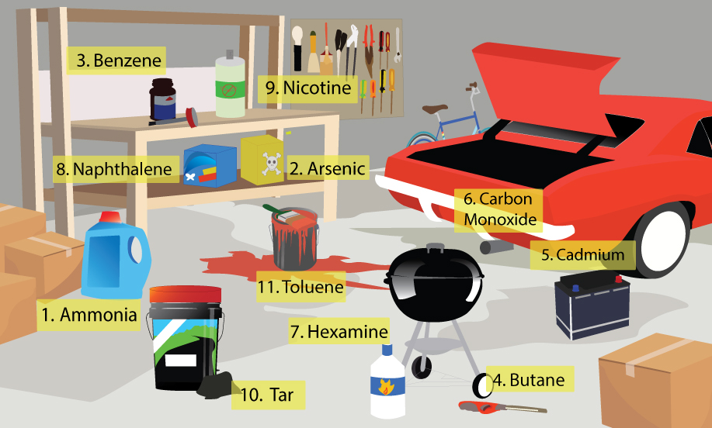
What Does Your Garage have in Common with a Cigarette?
SOURCE: American Lung Association, 2016.
Notes:
One cigarette probably has more chemicals than all the stuff you keep in your garage. Let's take a look:
Ammonia is one of the most commonly produced industrial chemicals in the United States, but you probably know it best as a household cleaner—the kind that you wear gloves around and avoid breathing in.
Arsenic is notorious for its use in rat poison. It's also one of the World Health Organization's 10 chemicals of major public health concern, along with two other ingredients on this list, benzene and cadmium.
Benzene is found in glues and adhesives—such as rubber cement—as well as car fumes and gasoline exhaust. But according to National Cancer Institute, cigarette smoking accounts for about half of the total U.S. population exposure to this cancer-causing chemical.
Butane is highly flammable and often used as fuel for lighters.
Cadmium is an active component in battery acid. Cadmium itself is classified as a human carcinogen, and smokers have about twice as much of it in their bodies as do non-smokers.
Carbon monoxide, a deadly, colorless, odorless, and poisonous gas, is released in car exhaust fumes as well as from a burning cigarette.
Hexamine is found in barbecue lighter fluid.
Naphthalene is an ingredient in moth balls, which are basically small balls of pesticide. Naphthalene turns directly from a solid into a toxic vapor, which in the case of mothballs kills insects and may repel animals.
Nicotine is the infamous addictive substance in tobacco products. It is also used as an insecticide because of its toxicity.
Tar is black and sticky material for paving roads. In cigarettes, it's the solid, sticky substance that remains after tobacco is burned, both in the ashtray and inside your lungs.
Toluene is used to manufacture paint and it's also found in gasoline. Exposure to toluene may affect the central nervous system.
REFERENCE:
American Lung Association. (2016). Accessed June 6, 2016 from http://www.lung.org/about-us/blog/2016/05/your-garage-and-a-cigarette.html.
Image Credit: American Lung Association website, 2016.

Slide 25
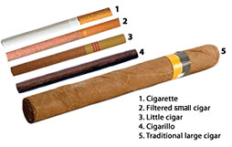
Cigars
Little cigars
Cigarillos
Large cigars
Notes:
Cigars are manufactured in three main forms – little cigars, cigarillos, and large cigars. The following three slides provide more detail on each type of cigar.
Image Credit: CDC website, 2016.

Slide 26
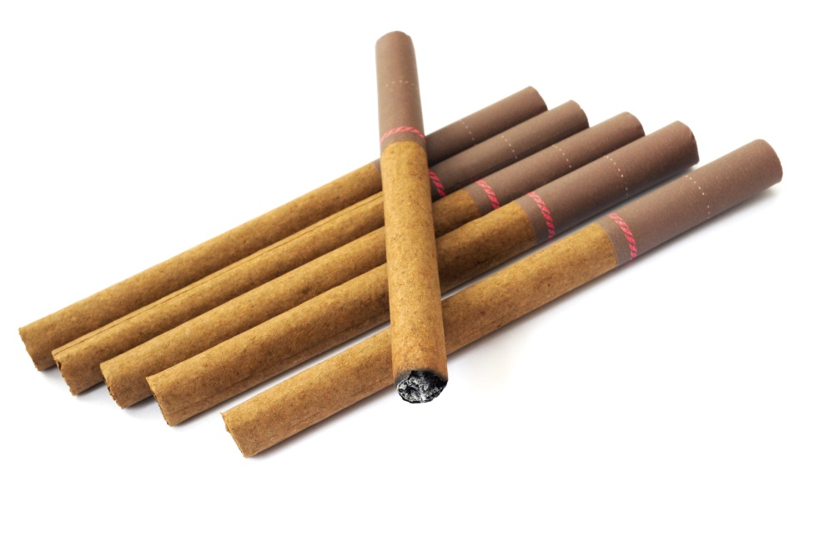
Little Cigars
Similar in size and appearance to cigarettes
Wrapped in brown paper that contains some tobacco leaf
Available in a number of flavors
Sold in packs of 20
Brands include Swisher Sweets©, Winchester©, and Cheyenne©
SOURCE: Slide courtesy of Kimberlee Homer Vagadori, 2015.
Notes:
Cigars are defined by the US government as “any roll of tobacco wrapped in leaf tobacco.” While there are currently three major cigar products—cigars, cigarillos and little cigars—current federal classifications narrowly define them into two categories: little cigars and large cigars. Little cigar flavors include vanilla, grape, watermelon, cherry, chocolate, and menthol, among others. The sale of little cigars increased by approximately 240% between 1997 and 2007. U.S. imports of little cigars increased from 34 million pieces in 1997 to 311 million pieces in 2007, an increase of more than 800%. As a point of comparison, large cigar imports jumped from 587 million to 889 million during the same time period, an increase of only 51%. According to tobacco industry documents, little cigars were intended to replace cigarettes as cigarette advertising became increasingly restricted, and taxes on cigarettes, but not cigars, continued to increase.
With regards to the health risks, some users have a misconception that little cigars are less addictive and less harmful than cigarettes, but in fact, little cigars, cigarillos, and large cigars contain the same compounds as cigarettes and can be just as harmful and addictive. Similar to cigarettes, all types of cigar products can cause various cancers and cigar smokers are at a greater risk of developing chronic obstructive pulmonary disease (COPD) than non-smokers.
REFERENCE:
American Legacy Foundation. (2009). Cigars, Cigarillos, & Little Cigars Fact Sheet. Washington, DC: Author.
Image Credit: Fotolia, 2016 (purchased image).

Slide 27
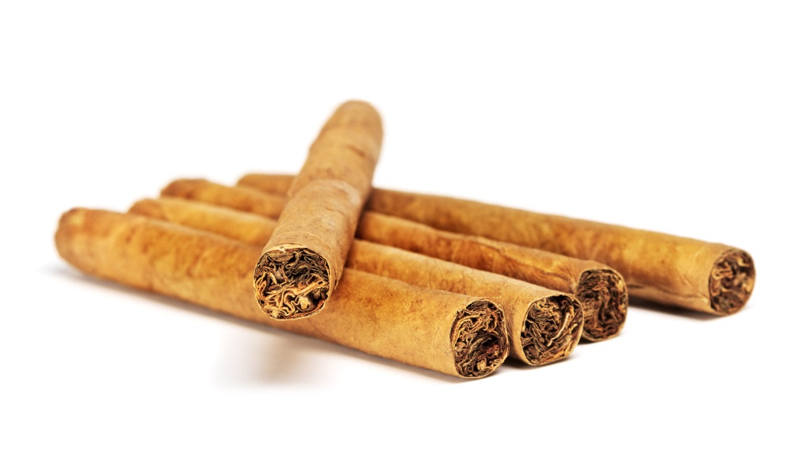
Cigarillos (a.k.a. “blunts”)
“Mid-size” cigars; grouped in the same category as large cigars
Also known as blunts
Can be tipped or untipped
Sold individually or in packages
SOURCE: Slide courtesy of Kimberlee Homer Vagadori, 2015.
Notes:
Cigarillos are grouped with large cigars in the Federal classifications because of their weight. Cigarillos are also called blunts or cheroots. All tobacco blunts are rolled in two sheets of tobacco. Similar to little cigars, cigarillos come in a variety of flavors, including cherry, apple, menthol, and wine, to name a few. The sale of cigarillos increased by about 150% between 1997 and 2007. With regards to the health risks, some users have a misconception that cigarillos are less addictive and less harmful than cigarettes, but in fact, little cigars, cigarillos, and large cigars contain the same compounds as cigarettes and can be just as harmful and addictive. Similar to cigarettes, all types of cigar products can cause various cancers and cigar smokers are at a greater risk of developing chronic obstructive pulmonary disease (COPD) than non-smokers.
REFERENCE:
American Legacy Foundation. (2009). Cigars, Cigarillos, & Little Cigars Fact Sheet. Washington, DC: Author.
Image Credit: Fotolia, 2016 (purchased image).

Slide 28
Large Cigars
Shredded tobacco wrapped in tobacco leaves
Cigar flavorings are not regulated by the federal government
Either rolled by hand or machine
Higher quality cigars are rolled by hand
Cheaper cigars are rolled by a machine
SOURCE: Slide courtesy of Kimberlee Homer Vagadori, 2015.
Notes:
Large cigars may contain as much tobacco as an entire pack of cigarettes. Cigars are wrapped in tobacco leaves and burn differently than cigarettes. As a result, cigar smoke has a higher concentration of toxins than cigarettes. Whereas the sale of little cigars and cigarillos increased between 1997 and 2007, the sale of large cigars actually decreased by 6% in that same time period.
With regards to the health risks, some users have a misconception that cigarillos are less addictive and less harmful than cigarettes, but in fact, little cigars, cigarillos, and large cigars contain the same compounds as cigarettes and can be just as harmful and addictive. Similar to cigarettes, all types of cigar products can cause various cancers and cigar smokers are at a greater risk of developing chronic obstructive pulmonary disease (COPD) than non-smokers.
REFERENCE:
American Legacy Foundation. (2009). Cigars, Cigarillos, & Little Cigars Fact Sheet. Washington, DC: Author.
Image Credit: Fotolia, 2016 (purchased image).

Slide 29
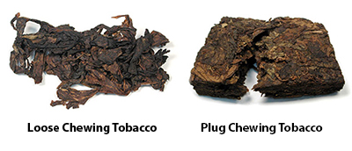
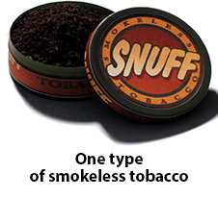
Smokeless Tobacco
Includes chewing tobacco (loose leaf, plug, twist) and snuff (dry and moist)
Available loose or in pouches
Multiple flavors
Energy Dip (long cut tobacco blend)
Snus (moist power tobacco sold in pouches)
SOURCE: Slide courtesy of Kimberlee Homer Vagadori, 2015.
Notes:
Several smokeless tobacco products are currently on the market, including chewing tobacco, snuff, Energy Dip, and snus. Popular brands of chewing tobacco include Skoal, Copenhagen, Timberwolf, and Grizzly. As with the other tobacco products that have been previously describe, smokeless tobacco comes in many different flavors, including mint, cinnamon, berry, grape, vanilla, and alcohol-flavored. Energy dip contains tobacco mixed with caffeine and other additives. Flavors include straight, wintergreen, and mint. Energy dip is marketed towards service members, civil servants, and consumers who could benefit from being alert, focused, and energized. Snus is consumed by placing the moist powder in the upper lip for at least 30 minutes. Popular brands include Camel and Marlboro.
Smokeless tobacco products are not a safe substitute to smoking cigarettes, as the products contain at least 28 known cancer-causing chemicals. As with other tobacco products, the use of smokeless tobacco can cause a number of cancers (e.g., oral, pancreatic, and esophageal) and other diseases, such as tooth decay, diseases of the mouth, and heart disease. A misconception exists that smokeless tobacco is effective in helping individuals quit smoking, but on the contrary, data show that smokeless tobacco use maintains nicotine dependence in individuals who quit smoking. Similar to cigarette smokers, smokeless tobacco users exhibit nicotine dependence.
Image Credits: CDC website, 2016.

Slide 30
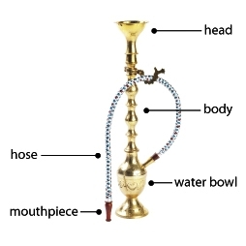
Hookah
Waterpipe used for smoking tobacco
Other names include shisha, narghile, and goza
Can also be used to smoke steam stones, herbs, cannabis, etc.
Mixture of shredded tobacco leaf and honey, molasses, or dried fruit.
Multiple flavors
SOURCE: Slide courtesy of Kimberlee Homer Vagadori, 2015.
30
Notes:
Waterpipe tobacco smoking, also known as hookah and shisha, has increased in popularity among young people in the United States. Hookah use is popular among youth and young adults, and is most common among 18-24 year olds, non-Hispanic whites, those with at least some college education, and current and former tobacco users. Hookah use is also increasingly becoming the first tobacco that young people try.
Steam stones are heat-treated, porous materials soaked in a fluid (typically a mix of glycerin and flavoring). The tobacco can come in many flavors, including apple, banana, peach, pineapple, rose, strawberry, tutti fruity, vanilla, watermelon, berry, chocolate, coconut, coffee, cola, grape, kiwi, lemon, licorice, mango, mint, orange, apricot, and bubblegum.
REFERENCES:
Meier, E.M., Tackett, A.P., Miller, M.B., Grant, D.M., & Wagener, T.L. (2015). Which nicotine products are gateways to regular use? First-tried tobacco and current use in college students. American Journal of Preventive Medicine, 48(1, Suppl 1), S86-S93.
Salloum, R.G., Osman, A., Maziak, W., & Thrasher, J.F. (2015). How popular is waterpipe tobacco smoking? Findings from internet search queries. Tobacco Control, 24(5), 509-513.
Salloum, R.G., Thrasher, J.F., Kates, F.R., & Maziak, W. (2015). Water pipe tobacco smoking in the United States: Findings from the National Adult Tobacco Survey. Preventive Medicine, 71, 88-93.
Image Credits (Top to Bottom): CDC website, 2016; Fotolia, 2016 (purchased image).

Slide 31
Hookah vs. Cigarettes
Hookah
Cigarettes
Single waterpipe episode typically lasts for about 60 minutes
Range from 20-80 minutes
User is likely to take 200 puffs per session, inhaling 90,000 ml of smoke
Single cigarette takes 5 -7 minutes to smoke
Smokers takes 10-13 puffs, inhaling 50 ml of smoke per puff (500-600 ml per cigarette)
A typical one-hour hookah session involves inhaling
100-200 times the volume of smoke inhaled with a single cigarette.
SOURCE: Slide courtesy of Kimberlee Homer Vagadori, 2015.
Notes:
Depending on the toxicant measured, a single waterpipe session produces the equivalent of at least 1 and as many as 50 cigarettes. Misconceptions about waterpipe smoke content may lead users to underestimate health risks. Specifically, compared to smoking one cigarette, a single session of smoking a water pipe is associated with 1.7 times the nicotine, 8.4 times the carbon monoxide, and 36 times the tar.
REFERENCE:
Cobb, C., Ward, K.D., Maziak, W., Shihadeh, A.L., & Eissenberg, T. (2010). Waterpipe tobacco smoking: An emerging health crisis in the United States. American Journal of Health Behaviors, 34(3), 275-285.

Slide 32
What do you think?
E-cigarettes are a safe alternative to smoking regular cigarettes.
True
False
Notes:
ANSWER KEY
The correct response is B (False)

Slide 33
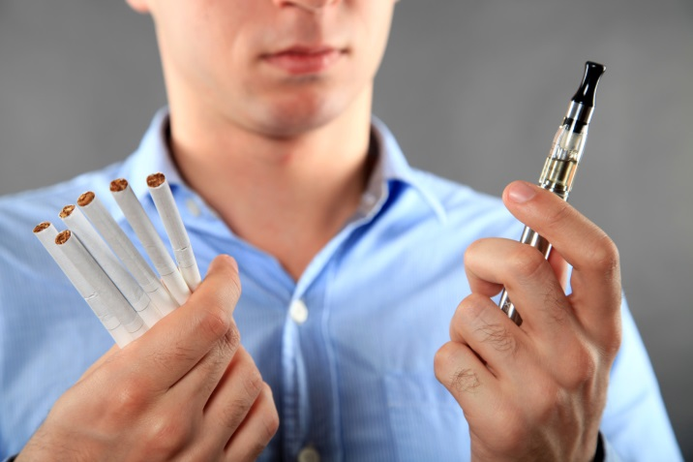
Electronic Cigarettes
Cig-a-Like
Same size/shape as cigarettes
Nicotine solution sold in pre-filled cartridge
Vape Pens
Larger device
May look like ink pen
User fills pen with nicotine solution
Mods or Tanks
Largest device
Contains big battery that creates more aerosol
Users fill with nicotine solution
Hookah Pens
Flavored e-cigarette designed to taste like hookah smoke
Often a bit larger than a cig-a-like
SOURCE: Slide courtesy of Kimberlee Homer Vagadori, 2015.
Notes:
Electronic cigarettes, which are also called e-cigarettes or electronic nicotine delivery systems, are battery-operated devices designed to deliver nicotine with flavorings and other chemicals to users in vapor instead of smoke. They can be manufactured to resemble traditional tobacco cigarettes, cigars or pipes, or even everyday items like pens or USB memory sticks. Newer devices, such as those with fillable tanks, may look different. More than 250 different e-cigarette brands are currently on the market. Four main types of electronic cigarettes (e-cigarettes) are marketed – cig-a-like, vape pens, mods or tanks, and hookah pens.
REFERENCE:
National Institute on Drug Abuse. (2016). Drug Facts: Electronic Cigarettes (e-cigarettes). Rockville, MD: NIDA, National Institutes of Health, U.S. Department of Health and Human Services.
Image Credit: Fotolia, 2016 (purchased image).

Slide 34
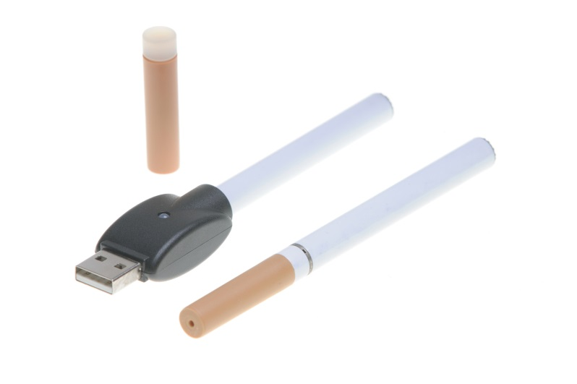
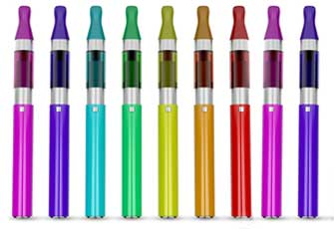
E-Cigarettes
Do not contain tobacco, but nicotine may be derived from tobacco
Solution includes three main ingredients
Propylene Glycolor Vegetable Glycerin (humectant)
Nicotine
Flavor
Can be used to smoke other substances
Cannabis
Alcohol
SOURCE: Slide courtesy of Kimberlee Homer Vagadori, 2015.
Notes:
Most e-cigarettes consist of three different components, including: (1) a cartridge that holds a liquid solution containing varying amounts of nicotine, flavorings, and other chemicals; (2) a heating device (vaporizer); and (3) a power source (usually a battery). In many types of e-cigarettes, puffing activates the battery-powered heating device, which vaporizes the liquid in the cartridge. The resulting aerosol or vapor is then inhaled (called "vaping").
E-cigarettes are designed to simulate the act of tobacco smoking by producing an appealingly flavored aerosol that looks and feels like tobacco smoke and delivers nicotine but with less of the toxic chemicals produced by burning tobacco leaves. Because they deliver nicotine without burning tobacco, e-cigarettes appear as if they may be a safer, less toxic alternative to conventional cigarettes, though insufficient evidence exists to determine whether or not this is the case. Although they do not produce tobacco smoke, e-cigarettes still contain nicotine and other potentially harmful chemicals.
Some people believe e-cigarette products may help smokers lower nicotine cravings while they are trying to discontinue their tobacco use. However, at this point it is unclear whether e-cigarettes may be effective as smoking cessation aids. There is also the possibility that they could perpetuate the nicotine addiction and thus interfere with quitting.
REFERENCE:
National Institute on Drug Abuse. (2016). Drug Facts: Electronic Cigarettes (e-cigarettes). Rockville, MD: NIDA, National Institutes of Health, U.S. Department of Health and Human Services.
Image Credits (Top to Bottom): Fotolia, 2016 (purchased image); CDC website, 2016.

Slide 35
E-Cigarette Use by Youth
Students who have used e-cigarettes by the time they start 9th grade are more likely than others to start smoking traditional cigarettes and other smokable tobacco products within the next year
SOURCE: Rigotti, 2015.
Notes:
E-cigarettes are increasingly popular among teens. Some states have banned sale of e-cigarettes to minors, but teens have been ordering them online. Their easy availability (online or via mall kiosks), in addition to their wide array of cartridge flavors (such as coffee, mint, candy, and fruit flavors), have helped make them particularly appealing to this age group. As a part of the FDA's new regulation to protect the health of our youth, minors will no longer be able to buy e-cigarettes in person or online.
In addition to the unknown health effects, early evidence suggests that e-cigarette use may serve as an introductory product for youth who then go on to use other tobacco products, including conventional cigarettes, which are known to cause disease and lead to premature death. A recent study showed that students who have used e-cigarettes by the time they start 9th grade are more likely than others to start smoking traditional cigarettes and other smokable tobacco products within the next year (Rigotti, 2015).
REFERENCES:
National Institute on Drug Abuse. (2016). Drug Facts: Electronic Cigarettes (e-cigarettes). Rockville, MD: NIDA, National Institutes of Health, U.S. Department of Health and Human Services.
Rigotti, N.A. (2015). E-cigarette use and subsequent tobacco use by adolescents: New evidence about a potential risk of e-cigarettes. Journal of the American Medical Association, 314(7), 673-674.
Image Credit: Fotolia, 2016 (purchased image).

Slide 36
Betel Quid with Tobacco
Combination of betel leaf, areca nut, and slaked lime
Tobacco is sometimes added (the product is known as gutka or ghutka)
Other ingredients are added, as well
Reported to have stimulant and relaxation effects
Used in the Indian subcontinent and throughout Asia and the Pacific Region
SOURCE: CDC, 2016.
Notes:
Betel quid is a combination of betel leaf, areca nut, and slaked lime. In may countries, tobacco is also added, and the product is known as gutka, ghutka, or gutkha. Global estimates report that up to 600 million men and women use some variety of betel quid. Betel quid with or without tobacco is widely use in the Indian subcontinent (e.g., Bangladesh, India, and Pakistan), as well as throughout Asia and the Pacific region (e.g., Cambodia, Indonesia, Malaysia, Philippines, Taiwan, and Thailand). Health effects include oral precancerous lesions and leukoplakia, oral submucous fibrosis, oral cancers, cancer of the esophagus, reproductive health outcomes, and nicotine addiction.
REFERENCE:
Centers for Disease Control and Prevention. (2016). Betel Quid with Tobacco (Gutka). Accessed June 6, 2016 from http://www.cdc.gov/tobacco/data_statistics/fact_sheets/smokeless/betel_quid/index.htm.
Image Credit: WHO, International Agency for Research on Cancer, 2004.

Slide 37
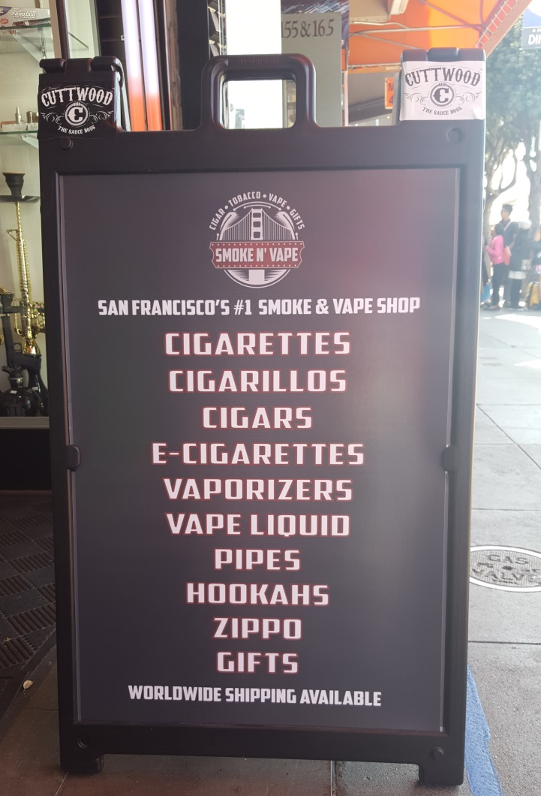
Commonalities among Non-Cigarette Tobacco Products
Flavors
Lack of regulation
Accessibility
Affordability
Myths and Misconceptions
Gateway to Cigarettes
Cessation Implications
SOURCE: Slide courtesy of Kimberlee Homer Vagadori, 2015.
Notes:
With regards to flavors, at this time, cigarettes are the only tobacco product that cannot be made with added flavors (other than menthol). Thousands of unique flavors of nicotine solution (e-juice) used in electronic cigarettes exist. Flavors are known to attract new users, especially youth and young adults. With regards to lack of regulation, non-cigarette tobacco products are not currently regulated by the FDA, and many products, such as hookah, smokeless tobacco, and e-cigarettes can be used in smoke-free environments.
Several issues related to accessibility exist. Many college campuses, such as UCLA, include hookah stores and lounges on or near campus. Many retailers are in close proximity to schools. According to one data source, in California, 75% of retailers near schools sell flavored non-cigarette tobacco products. Non-cigarette tobacco products are not taxed at all or are taxed differently than cigarettes, making them more affordable. Not all tobacco products are sold in packs, such as cigarillos or little cigars, so single quantity products may be purchased for under $1. Smoking devices, such as a hookah, can be made at home with liquor/beverage bottles and tubing.
Many myths and misconceptions exist with regards to the safety of alternative tobacco products. Some users feel that they are safer than cigarettes or may serve as a smoking cessation aid. Others feel that because they do not use the products daily, they can quit at any time. For some, something that smells good cannot possibly be bad for them; and for others, because they do not smoke cigarettes, they do not consider themselves a smoker.
Numerous studies have concluded that alternative tobacco products may lead people to use cigarettes; and there is growing evidence that e-cigarettes in particular act as a gateway to regular cigarettes. At least six studies that were published in 2015 along came to the conclusion that youth who use e-cigarettes are more likely to smoke traditional cigarettes. Lastly, with regards to cessation implications, cessation may need to be approached differently with non-daily or light tobacco users. The type of treatment (e.g., behavioral intervention, NRT) may be different; promotion of cessation services may need to be adapted so that nondaily users pay attention; and dual use of multiple different types of tobacco products needs to be a focus of cessation efforts (those who use multiple types of alternative tobacco products may actual have a greater dependence on nicotine due to more consistent use throughout the day).
Image Credit: Beth Rutkowski personal image, 2016.

Slide 38
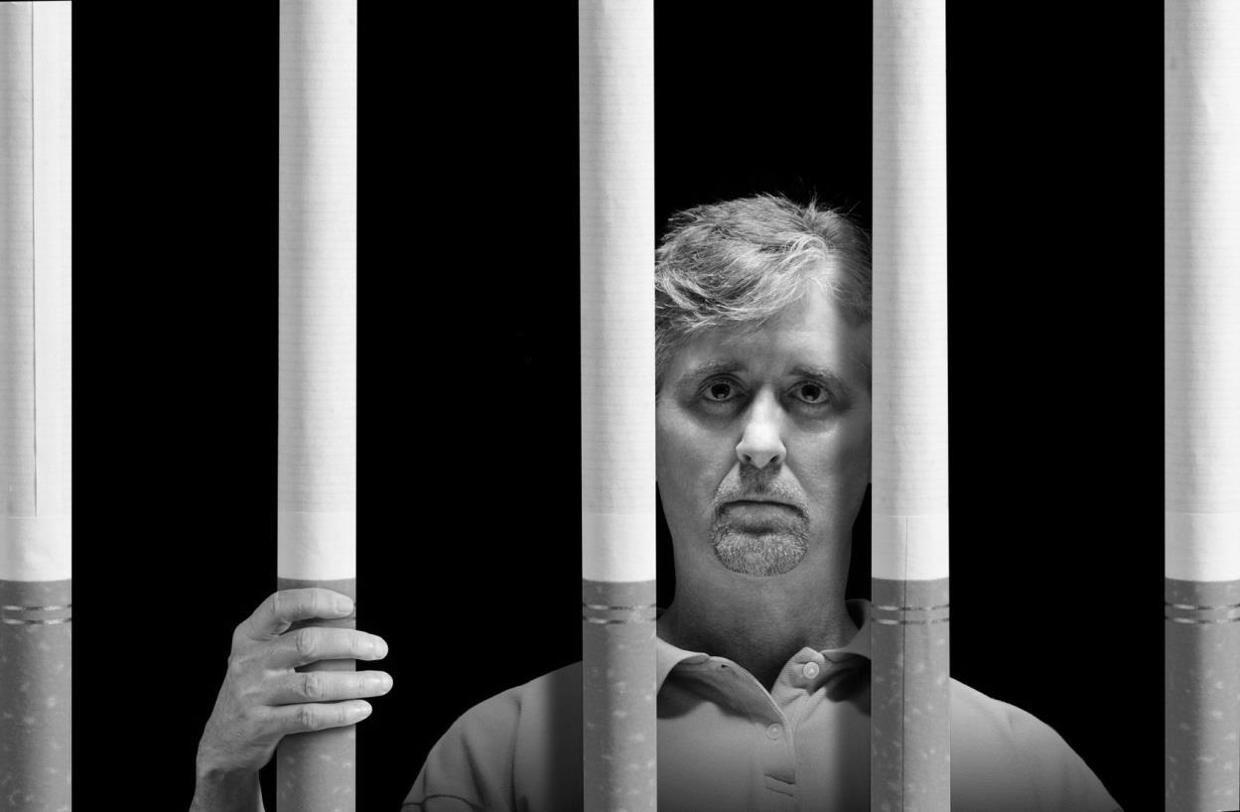
The Health Impacts of Smoking
Notes:
TRANSITION SLIDE
Nicotine is a highly addictive drug, and recent research suggests nicotine exposure may also prime the brain to become addicted to other substances. The following section describes the health impacts of smoking.
Image Credit: Fotolia, 2016 (purchased image).

Slide 39
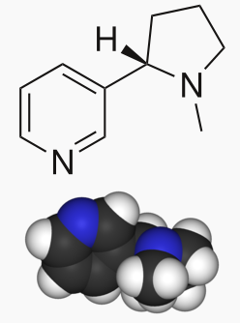
Nicotine
Tobacco is an addictive substance because it contains the chemical nicotine
Like heroin or cocaine, nicotine changes the way your brain works and causes you to crave more and more nicotine
This addiction to nicotine is what makes it so difficult to quit smoking and using other tobacco products
SOURCE: US DHHS, 2016.
Notes:
Nicotine is a potent parasypathomimetic alkaloid and is a stimulant drug found in the tobacco plant. More than 7,000 chemicals are found in the smoke of tobacco products. Of these, nicotine, first identified in the early 1800s, is the primary reinforcing component of tobacco. Nicotine is addictive. The stimulant effect is a contributing factor to the addictive properties of tobacco smoking. Nicotine’s addictive nature includes psychoactive effects, drug-reinforced behavior, compulsive use, relapse after abstinence, physical dependence, and tolerance.
REFERENCE:
US Department of Health and Human Services. (2016). Tobacco and Nicotine. Accessed May 27, 2016 from http://betobaccofree.hhs.gov/about-tobacco/tobacco-and-nicotine/index.html.
Image Credit: Wikipedia, 2016.

Slide 40
Test Your Knowledge
Nicotine reaches the brain faster when you inhale cigarette smoke vs. chew smokeless tobacco.
True
False
Notes:
ANSWER KEY
The correct response is A (True)

Slide 41
How Does Tobacco Deliver its Effects?
1-2 milligrams of nicotine are inhaled in tobacco smoke
When tobacco is smoked, nicotine rapidly reaches peak levels in the bloodstream and enters the user’s brain
An average smoker will take 10 puffs of a cigarette over a period of 5 minutes
With tobacco products in which the user does not inhale the smoke (cigar and pipe, smokeless tobacco), nicotine is absorbed through the mucosal membranes and reaches peak blood levels and the brain more slowly
SOURCE: NIDA, 2016.
Notes:
Cigarette smoking is the most popular method of using tobacco; however, many people also use smokeless tobacco products, such as snuff and chewing tobacco. These smokeless products also contain nicotine, as well as many toxic chemicals. The cigarette is a very efficient and highly engineered drug delivery system. By inhaling tobacco smoke, the average smoker takes in 1–2 milligrams of nicotine per cigarette. When tobacco is smoked, nicotine rapidly reaches peak levels in the bloodstream and enters the brain. A typical smoker will take 10 puffs on a cigarette over a period of 5 minutes that the cigarette is lit. Thus, a person who smokes about 1½ packs (30 cigarettes) daily gets 300 "hits" of nicotine to the brain each day. In those who typically do not inhale the smoke—such as cigar and pipe smokers and smokeless tobacco users—nicotine is absorbed through the mucosal membranes and reaches peak blood levels and the brain more slowly.
Immediately after exposure to nicotine, there is a "kick" caused in part by the drug’s stimulation of the adrenal glands and resulting discharge of epinephrine (adrenaline). The rush of adrenaline stimulates the body and causes an increase in blood pressure, respiration, and heart rate.
REFERENCE: National Institute on Drug Abuse. (2016). Research Report Series: Tobacco/Nicotine. Rockville, MD: National Institutes of Health, US Department of Health and Human Services.
Image Credit: NIDA website, 2016.

Slide 42
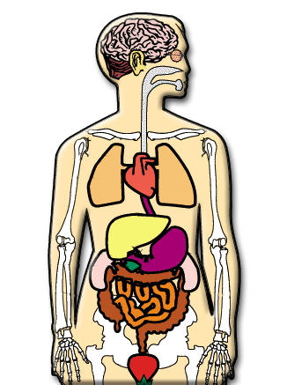
Mechanism of Action of Nicotine
Nicotine affects the entire body
Changes heart rate and blood pressure
Acts on nerves that control respiration; changes breathing patterns
Acts in the brain to stimulate feelings of pleasure
SOURCE: NIDA, 2016.
Notes:
Nicotine affects the entire body. Nicotine acts directly on the heart to change heart rate and blood pressure. It also acts on the nerves that control respiration to change breathing patterns. In high concentrations, nicotine is deadly, in fact one drop of purified nicotine on the tongue will kill a person. It's so lethal that it has been used as a pesticide for centuries. So why do people smoke? Because nicotine acts in the brain where it can stimulate feelings of pleasure.
When tobacco is smoked, nicotine is absorbed by the lungs and quickly moved into the bloodstream, where it is circulated throughout the brain. All of this happens very rapidly. In fact, nicotine reaches the brain within 8 seconds after someone inhales tobacco smoke. Nicotine can also enter the bloodstream through the mucous membranes that line the mouth (if tobacco is chewed) or nose (if snuff is used), and even through the skin.
REFERENCE:
National Institute on Drug Abuse. (2016). Mind Over Matter: Nicotine. Accessed May 15, 2016 from https://teens.drugabuse.gov/teachers/mind-over-matter/nicotine.
Image Credit: NIDA website, 2016.

Slide 43
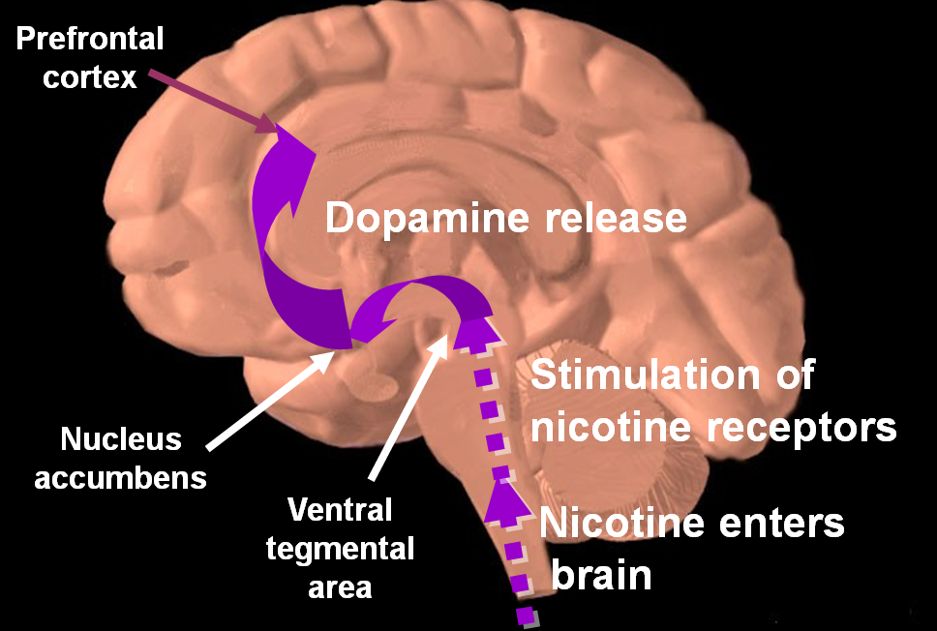
How Nicotine Works in the Brain
SOURCE: Slide courtesy of Steven A. Schroeder, MD, 2015.
Notes:
The human brain is made up of billions of nerve cells. They communicate by releasing chemical messengers called neurotransmitters. Each neurotransmitter is like a key that fits into a special "lock," called a receptor, located on the surface of nerve cells. When a neurotransmitter finds its receptor, it activates the receptor's nerve cell.
The nicotine molecule is shaped like a neurotransmitter called acetylcholine. Acetylcholine and its receptors are involved in many functions, including muscle movement, breathing, heart rate, learning, and memory. They also cause the release of other neurotransmitters and hormones that affect your mood, appetite, memory, and more. When nicotine gets into the brain, it attaches to acetylcholine receptors and mimics the actions of acetylcholine.
Nicotine also activates areas of the brain that are involved in producing feelings of pleasure and reward. Recently, scientists discovered that nicotine raises the levels of a neurotransmitter called dopamine in the parts of the brain that produce feelings of pleasure and reward. Dopamine, which is sometimes called the pleasure molecule, is the same neurotransmitter that is involved in addictions to other drugs such as cocaine and heroin. Researchers now believe that this change in dopamine may play a key role in all addictions. This may help explain why it is so hard for people to stop smoking.
Drugs such as cocaine, heroin, amphetamine, and nicotine exert profound effects on the brain. These agents have in common the ability to stimulate the release of the neurotransmitter dopamine in the midbrain. Dopamine induces feelings of euphoria and pleasure and is responsible for activating the dopamine reward pathway (Leshner, 1997).
The dopamine reward pathway, as depicted in this simplified diagram, is a network of nervous tissue in the middle of the brain that elicits feelings of pleasure in response to certain stimuli. The important interconnected structures of the reward pathway include the ventral tegmental area (VTA), the nucleus accumbens, and the prefrontal cortex (area of the brain responsible for thinking and judgment). The neurons of the VTA contain the neurotransmitter dopamine, which is released in the nucleus accumbens and in the prefrontal cortex.
Behaviors that naturally stimulate the reward pathway include eating to relieve hunger, drinking to alleviate thirst, or engaging in sexual activity. On a primitive, neurochemical level, stimulation of the reward pathway reinforces the behavior so that it will be repeated. Obviously these behaviors are necessary for continued survival of the organism. The reward pathway can also be stimulated by drugs of abuse such as cocaine, opiates, amphetamine, and nicotine. When these unnatural stimuli trigger the reward pathway the same pleasurable feelings are elicited. Researchers believe that, with chronic drug use, the brain becomes chemically altered—transforming a drug user into a drug addict (Leshner, 1997).
Consider cigarette smoking as an example. Immediately following inhalation, a bolus of nicotine enters the brain, stimulating the release of dopamine, which induces nearly immediate feelings of pleasure and relief of symptoms of nicotine withdrawal. This rapid dose-response reinforces and perpetuates the smoking behavior.
NOTE: This slide is made available to the public through the National Institute on Drug Abuse Web page, at www.nida.nih.gov/Teaching/largegifs/slide-9.gif. Adapted with permission by Dr. Rochelle D. Schwartz-Bloom, Duke University.
REFERENCE:
Leshner, A. (1997). Drug abuse and addiction are biomedical problems. Hospital Practice, Special Report, 2-4.

Slide 44
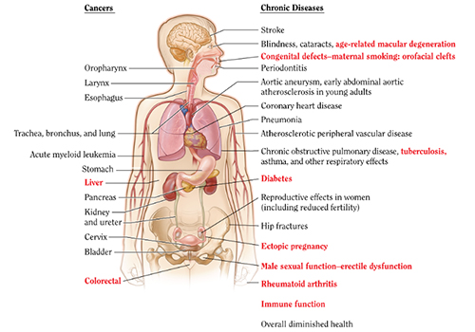
Health Effects of Cigarette Smoking
SOURCE: CDC, 2016.
Notes:
Cigarette smoking harms nearly every organ of the body, causes many diseases, and reduces the health of smokers in general. Quitting smoking lowers your risk for smoking-related diseases and can add years to your life.
Smoking can make it harder for a woman to become pregnant and can affect her baby's health before and after birth. Smoking increases risks for: preterm (early) delivery; stillbirth (death of the baby before birth); low birth weight; sudden infant death syndrome (known as SIDS or crib death); ectopic pregnancy; and orofacial clefts in infants.
Smoking can also affect men's sperm, which can reduce fertility and also increase risks for birth defects and miscarriage. Smoking can affect bone health. Women past childbearing years who smoke have weaker bones than women who never smoked, and are at greater risk for broken bones.
Smoking affects the health of your teeth and gums and can cause tooth loss. Smoking can increase your risk for cataracts (clouding of the eye’s lens that makes it hard for you to see) and age-related macular degeneration (damage to a small spot near the center of the retina, the part of the eye needed for central vision). Smoking is a cause of type 2 diabetes mellitus and can make it harder to control. The risk of developing diabetes is 30–40% higher for active smokers than nonsmokers. Smoking causes general adverse effects on the body, including inflammation and decreased immune function. Smoking is a cause of rheumatoid arthritis.
REFERENCES:
U.S. Department of Health and Human Services. (2014). The Health Consequences of Smoking – 50 Years of Progress: A Report from the Surgeon General. Atlanta, GA: U.S. DHHS, Centers for Disease Control and Prevention and Health Promotion, Office of Smoking and Health.
U.S. Department of Health and Human Services. (2010). How Tobacco Smoke Causes Disease: What It Means to You. Atlanta: U.S. DHHS, Centers for Disease Control and Prevention, National Center for Chronic Disease Prevention and Health Promotion, Office on Smoking and Health.
U.S. Department of Health and Human Services. (2001). Women and Smoking: A Report of the Surgeon General. Rockville (MD): U.S. DHHS, Public Health Service, Office of the Surgeon General.
Image Credit: CDC website, 2016.

Slide 45
Enzyme Level Differences between Smokers and Non-Smokers
SOURCE: NIDA, 2012.
Notes:
Scientists can use advanced neuroimaging technology to see the dramatic effect of cigarette smoking on the brain and body. Findings include a marked decrease in the levels of monoamine oxidase (MAO B), an important enzyme that is responsible for the breakdown of dopamine (Source: Fowler et al., 2003).
REFERENCE: National Institute on Drug Abuse. (2012). Tobacco/Nicotine. Accessed May 15, 2016 from https://www.drugabuse.gov/publications/research-reports/tobacco/what-are-medical-consequences-tobacco-use.
Image Credit: NIDA website, 2016.

Slide 46
The Impact of Smoking on the User’s Lungs
SOURCE: NIDA, 2016.
Notes:
Sticky, brown tar coats the lungs of tobacco smokers. Along with thousands of other damaging chemicals, tar can lead to lung cancer and acute respiratory diseases. The image on the left is that of the lung of a health, non-smoker. The image on the left is that of a smoker’s lung.
Image Credit: NIDA, 2016.

Slide 47
Effects of Cigarette Smoking on the Brain Differ between Men and Women
Dopamine release in nicotine-dependent men occurred in the ventral striatum, the part of the brain associated with drug reinforcement
In women, dopamine response was found in the dorsal striatum, associated with habit formation
Men tend to be reinforced by the nicotine in cigarettes, while women smoke for reasons that may be related to mood or from habit
SOURCE: Cosgrove et al., 2014.
Notes:
Researchers from Yale University discovered that brain activation during smoking occurs differently in men than in women. The research used a new method of brain imaging scan analysis, and was funded by NIDA and the NIH Office of Research on Women’s Health. The study showed that dopamine release in nicotine-dependent men during smoking occurred in the part of the brain (ventral striatum) associated with drug reinforcement. The dopamine response in women was found within a part of the brain (dorsal striatum) associated with habit formation. The scientists suggest that these findings support previously published data that shows men tend to be reinforced by the nicotine in cigarettes, while women, though no less dependent on nicotine, smoke for reasons that may be related to mood or from habit. Understanding the differences of nicotine’s impact on the brains of both men and women could help identify effective gender-sensitive approaches to smoking cessation.
REFERENCE:
Cosgrove, K.P., Wang, S., Kim, S.-J., McGovern, E., Nabulsi, N., Gao, H., Labaree, D., Tagare, H.D., Sullivan, J.M., & Morris, E.D. (2014). Sex differences in the brain’s dopamine signature of cigarette smoking. Journal of Neuroscience, 34(50), 16851-16855.

Slide 48
Smoking and Pregnancy
An estimated 16% of pregnant women smoke during their pregnancies
Carbon monoxide and nicotine from tobacco smoke may interfere with the oxygen supply to the fetus
Adverse effects include fetal growth retardation and decreased birthweight
Smoking during pregnancy may also be also associated with spontaneous abortion and sudden infant death syndrome (SIDS)
SOURCE: NIDA, 2016.
Notes:
In the United States, it is estimated that about 16% of pregnant women smoke during their pregnancies. Carbon monoxide and nicotine from tobacco smoke may interfere with the oxygen supply to the fetus. Nicotine also readily crosses the placenta, and concentrations in the fetus can be as much as 15 percent higher than maternal levels. Nicotine concentrates in fetal blood, amniotic fluid, and breast milk. Combined, these factors can have severe consequences for the fetuses and infants of smoking mothers. Smoking during pregnancy caused an estimated 910 infant deaths annually from 1997 through 2001, and neonatal care costs related to smoking are estimated to be more than $350 million per year.
The adverse effects of smoking during pregnancy can include fetal growth retardation and decreased birthweight. The decreased birthweights seen in infants of mothers who smoke reflect a dose-dependent relationship—the more the woman smokes during pregnancy, the greater the reduction of infant birthweight. These newborns also display signs of stress and drug withdrawal consistent with what has been reported in infants exposed to other drugs. In some cases, smoking during pregnancy may be associated with spontaneous abortions and sudden infant death syndrome (SIDS), as well as learning and behavioral problems and an increased risk of obesity in children. In addition, smoking more than one pack a day during pregnancy nearly doubles the risk that the affected child will become addicted to tobacco if that child starts smoking.
REFERENCE:
National Institute on Drug Abuse. (2016). Research Report: Tobacco Smoking and Pregnancy. Accessed May 15, 2016 from: https://www.drugabuse.gov/publications/research-reports/tobacco/smoking-pregnancy%E2%80%94-what-are-risks.
Image Credit: NIDA, 2016.

Slide 49
SOURCE: CDC, 2016.
49
Notes:
This image appeared in an Infographic released by the CDC in 2016 to warn young people of the dangers in using e-cigarettes.

Slide 50
Causal Associations with Second-Hand Smoke
Developmental
Low birthweight
Sudden Infant Death Syndrome (SIDS)
Pre-term delivery
Childhood depression
Respiratory
Asthma induction and exacerbation
Eye and nasal irritation
Bronchitis, pneumonia, otitis media, bruxism in children
Decreased hearing in teens
SOURCE: Slide courtesy of Steven A. Schroeder, MD, 2015.
Notes:
According to a study conducted by CDC-funded researchers, nearly 50% of non-smoking youth in middle and high school encountered second-hand smoke in 2013, and rates were even higher among smokers. The U.S. Surgeon General has concluded that there is no safe level of secondhand smoke exposure.
REFERENCE:
Agaku, I.T., Singh, T., Rolle, I., Olalekan, A-Y, & King, B.A. (2016). Prevalence and determinants of seconhand smoke exposure among middle and high school students. Pediatrics, 13(2), 1-9.

Slide 51
Causal Associations with Second-Hand Smoke
Carcinogenic
Lung cancer
Nasal sinus cancer
Breast cancer? (younger, premenopausal women)
Cardiovascular
Heart disease mortality
Acute and chronic coronary heart disease morbidity
Altered vascular properties
SOURCE: Slide courtesy of Steven A. Schroeder, MD, 2015.
Notes:
No safe level of second-hand smoke exists. We also are aware of something known as third-hand smoke, which is the residue that remains after a cigarette has been extinguished.

Slide 52
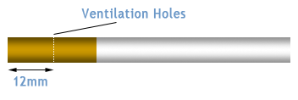
Nicotine Addiction
Tobacco users maintain a minimum serum nicotine concentration in order to
Prevent withdrawal symptoms
Maintain pleasure/arousal
Modulate mood
Users self-titrate nicotine intake by
Smoking more frequently
Smoking more intensely
Obstructing vents on low-nicotine brand cigarettes
SOURCE: Slide courtesy of Steven A. Schroeder, MD, 2015.
Notes:
As was shown in the previous slide, tobacco users tend to carefully titrate, or regulate, their tobacco intake to maintain a relatively constant level of nicotine in the body, in order to:
Prevent withdrawal symptoms
Maintain pleasure/arousal
Modulate mood (e.g., to handle stress or anxiety)
Although many tobacco users might not think about it consciously, they are able to alter nicotine delivery in a number of ways, including:
By smoking or dipping more frequently
By smoking more intensely (e.g., inhaling deeper or longer, smoking cigarette down to the filter)
By obstructing the vents (with fingers or lips) on “light” cigarettes, thereby increasing the amount of nicotine delivered to the lung
REFERENCES:
Benowitz, N.L. (2008). Clinical pharmacology of nicotine: Implications for understanding, preventing, and treating tobacco addiction. Clinical Pharmacology and Therapeutics, 83, 531-41.
Benowitz, N.L. (1999). Nicotine addiction. Primary Care, 26, 611-631.

Slide 53
Withdrawal Symptoms
Anxiety
Irritability
Impatience
Restlessness
Trouble concentrating
Dizziness
Trouble sleeping
Depression
Headaches
Increased appetite
SOURCE: The Body: The Complete HIV/AIDS Resource, accessed April 27, 2016.
Notes:
Physical dependence to nicotine can cause a variety of uncomfortable withdrawal symptoms, as is detailed in the bulleted lists that appear on this slide. Withdrawal symptoms are usually at their worst 2-3 days after quitting, and gradually improve after several weeks. Overcoming the emotional dependence on tobacco use may be as hard, or harder than overcoming the physical dependence. For many people, smoking becomes an essential part of a daily routine, or can be a means to relaxing or handling stress, boredom, or anxiety.

Slide 54
Smoking and Behavioral Health
Half of the annual smoking-related deaths in the U.S. occur among patients with chronic mental illness and/or substance abuse (240,000 of 480,000)
This population consumes 40% of all cigarettes sold in the United States
Higher prevalence
Smoke more
More likely to smoke down to the butt
SOURCE: Slide courtesy of Steven A. Schroeder, MD, 2015.
Notes:
About half of annual smoking-related deaths in the United States are among individuals with a chronic mental illness and/or substance abuse issue. Further, persons with mental illness smoke nearly half of all cigarettes produced, but are only half as likely to quit as other smokers.
REFERENCE:
UCSF Smoking Cessation Leadership Center. (2016). Behavioral Health. Accessed August 26, 2016 from https://smokingcessationleadership.ucsf.edu/behavioral-health.
Image Credit: ATTC Network, purchased image.

Slide 55
Smoking and Behavioral Health
People with chronic mental illness die earlier than others
Smoking is a large contributor to that early mortality
Greater risk for nicotine withdrawal
Social isolation from smoking compounds the social stigma
SOURCE: Slide courtesy of Steven A. Schroeder, MD, 2015.
Notes:
Persons with mental or substance use disorders die, on average, about five years prematurely than persons without these disorders. At the same time, this population experiences higher rates of disease, premature death, and reduced quality of life.
REFERENCE:
UCSF Smoking Cessation Leadership Center. (2016). Behavioral Health. Accessed August 26, 2016 from https://smokingcessationleadership.ucsf.edu/behavioral-health.
Image Credit: ATTC Network, purchased image.

Slide 56
Smoking and Death
Cigarette smoking is the leading preventable cause of death in the United States.
Causes more than 480,000 deaths each year in the United States (nearly 20% of all deaths)
Smoking causes more deaths each year than the following causes combined:
Human immunodeficiency virus (HIV)
Illegal drug use
Alcohol use
Motor vehicle injuries
Firearm-related incidents
SOURCE: CDC, 2016.
Notes:
Cigarette smoking causes about one in every five deaths in the United States each year. Overall mortality among both male and female smokers in the U.S. is about three times higher than that among similar people who never smoked. The major causes of excess mortality among smokers are diseases that are related to smoking, including cancer and respiratory and vascular disease.
REFERENCES: U.S. Department of Health and Human Services. (2014). The Health Consequences of Smoking-50 Years of Progress: A Report of the Surgeon General. Atlanta: U.S. DHHS, Centers for Disease Control and Prevention, National Center for Chronic Disease Prevention and Health Promotion, Office on Smoking and Health.
Centers for Disease Control and Prevention. (2013). QuickStats: Number of deaths from 10 leading causes – National Vital Statistics System, United States, 2010. Morbidity and Mortality Weekly Report, 62(08),155.
U.S. Department of Health and Human Services. (2010). How Tobacco Smoke Causes Diseases: What It Means to You. Atlanta: U.S. DHHS, Centers for Disease Control and Prevention, National Center for Chronic Disease Prevention and Health Promotion, Office on Smoking and Health.
Mokdad, A.H., Marks, J.S., Stroup, D.F., & Gerberding, J.L. (2004). Actual causes of death in the United States. Journal of the American Medical Association, 291(10), 1238-1245.

Slide 57
Smoking and Death
The risk of dying from cigarette smoking has increased over the last 50 years in men and women in the United States.
More than 10 times as many U.S. citizens have died prematurely from cigarette smoking than have died in all the wars fought by the U.S. during its history
Causes about 90% (or 9 out of 10) of all lung cancer deaths in men and women
Causes about 80% (or 8 out of 10) of all deaths from chronic obstructive pulmonary disease (COPD)
SOURCE: CDC, 2016.
Notes:
Cigarette smoking increases risk for death from all causes in men and women. More women die from lung cancer each year than from breast cancer.
REFERENCES:
U.S. Department of Health and Human Services. (2014). The Health Consequences of Smoking-50 Years of Progress: A Report of the Surgeon General. Atlanta: U.S. DHHS, Centers for Disease Control and Prevention, National Center for Chronic Disease Prevention and Health Promotion, Office on Smoking and Health.
U.S. Department of Health and Human Services. (2010). How Tobacco Smoke Causes Disease: What It Means to You. Atlanta: U.S. DHHS, Centers for Disease Control and Prevention, National Center for Chronic Disease Prevention and Health Promotion, Office on Smoking and Health.
U.S. Department of Health and Human Services. (2001). Women and Smoking: A Report of the Surgeon General. Rockville (MD): U.S. DHHS, Public Health Service, Office of the Surgeon General.

Slide 58
Trends in the Use of Tobacco Products
Notes:
TRANSITION SLIDE
The next section of the presentation presents data on the extent of the use of tobacco products in the United States. No single indicator or data source can tell the full story of the extent or impact of tobacco use. Therefore, data from several available indicators are presented in an attempt to paint a comprehensive picture of who uses tobacco, and the populations in which use is most prevalent.
Image Credit: Fotolia, 2016 (purchased image).

Slide 59
Test Your Knowledge
Traditional cigarette use is on a downward trend among adolescents, young adults, and adults.
True
False
Notes:
ANSWER KEY
The correct response is A (True)

Slide 60
Smoking and Tobacco Use: By the Numbers
Worldwide, tobacco use causes nearly 6 million deaths per year
More than 16 million Americans are living with a disease caused by smoking
On average, smokers die 10 years earlier than non-smokers
If smoking continues at current rate among youth, 5.6 million Americans under the age of 18 are expected to die prematurely from a smoking-related illness
SOURCE: Mee-Lee, 2016; CDC, 2015.
Notes:
As was previously mentioned, smoking leads to disease and disability, and impacts nearly every organ of the body. For every person who dies because of smoking, there are at least 30 people who live with a smoking-related illness. If current trends in tobacco-related deaths continue, there will be more than 8 million tobacco-related deaths by 2030.
REFERENCES:
Mee-Lee, D. (2016). David Mee-Lee’s tips and topics. Volume 13, Number 10, January 2016.
Centers for Disease Control and Prevention. (2015). Fast Facts. Accessed May 16, 2016 from http://www.cdc.gov/tobacco/data_statistics/fact_sheets/fast_facts/.

Slide 61
U.S. Trends in Adult Smoking by Gender, 1955-2013
Trends in cigarette current smoking among persons aged 18 or older
17.8% of adults are current smokers
Male
Percent
Female
20.5%
15.3%
68.8% want to quit
Graph provided by the Centers for Disease Control and Prevention. 1955 Current Population Survey; 1965–2013 NHIS. Estimates since 1992 include some-day smoking.
Notes:
This slide is courtesy of Steven A. Schroeder, MD, SCLC, UCSF, 2015.
According to the CDC, more than 480,000 deaths each year are caused by cigarette smoking. Tobacco use and smoking do damage to nearly every organ in the human body, often leading to lung cancer, respiratory disorders, heart disease, stroke, and other illnesses.
In 2014, an estimated 66.9 million Americans aged 12 or older were current users of a tobacco product (25.2%). Young adults aged 18 to 25 had the highest rate of current use of a tobacco product (35%), followed by adults aged 26 or older (25.8%), and by youths aged 12 to 17 (7%).
In 2014, the prevalence of current use of a tobacco product was 37.8% for American Indians or Alaska Natives, 27.6% for whites, 26.6% for blacks, 30.6% for Native Hawaiians or other Pacific Islanders, 18.8% for Hispanics, and 10.2% for Asians.

Slide 62
U.S. Trends in Past Month Use of Cigarettes and Smokeless Tobacco, 2014
Past month cigarette and smokeless tobacco use was highest among 18 to 25 year olds
SOURCE: SAMHSA, CBHSQ, National Survey on Drug Use and Health, 2014 results.
Notes:
According to the 2014 National Survey on Drug Use and Health, individuals aged 18 to 25 were most likely to self-report past year or past month use of cigarettes and smokeless tobacco.
The Substance Abuse and Mental Health Services Administration (SAMHSA), an operating division within the U.S. Department of Health and Human Services, is charged with reducing the impact of substance abuse and mental illness on America’s communities. SAMHSA is pursuing this mission at a time of significant change. Health reform has been enacted, bringing sweeping changes to how the United States delivers, pays for, and monitors health care. Examining trends in behavioral health data is critical to providing the most appropriate and highest quality behavioral health care. Each year, SAMHSA publishes the most recent annual results from the National Survey on Drug Use and Health (NSDUH). This survey is the primary source of statistical information on the use of illegal drugs, alcohol, and tobacco by the civilian, noninstitutionalized population of the United States aged 12 years old or older. The survey also covers mental health issues, allowing for a comprehensive look at the behavioral health of the United States.
REFERENCE: Center for Behavioral Health Statistics and Quality. (2015). Behavioral health trends in the United States: Results from the 2014 National Survey on Drug Use and Health (HHS Publication No. SMA 15-4927, NSDUH Series H-50). Retrieved from http://www.samhsa.gov/data/.

Slide 63
Good News: Conventional Cigarette Use has Decreased Significantly among Adolescents in the U.S.
SOURCE: CDC, Youth Risk Behavior Survey, 2011-2015 results.
Notes:
While there has been no significant change in overall tobacco use among high school students since 2011 (data not shown), according to the Youth Risk Behavioral Surveillance System, there was a significant decrease in current cigarette us among high school students during the same time period.
The YRBSS was developed in 1990 to monitor priority health risk behaviors that contribute markedly to the leading causes of death, disability, and social problems among youth and adults in the United States. These behaviors, often established during childhood and early adolescence, include (1) behaviors that contribute to unintentional injuries and violence; (2) sexual behaviors related to unintended pregnancy and sexually transmitted infections, including HIV infection; (3) alcohol and other drug use; (4) tobacco use; (5) unhealthy dietary behaviors; and (6) inadequate physical activity. In addition, the YRBSS monitors the prevalence of obesity and asthma and other priority health-related behaviors plus sexual identity and sex of sexual contacts.

Slide 64
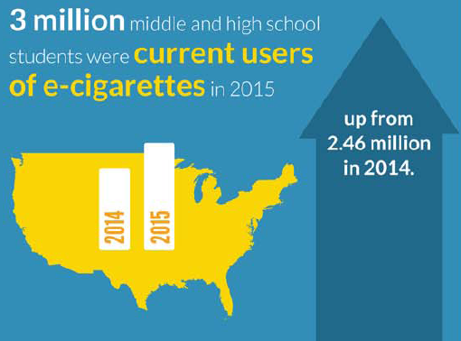
Bad News: E-Cigarette Use has Increased among U.S. Adolescents
SOURCE: CDC, Youth Risk Behavior Survey, 2014-2015 results.
Notes:
While the previous slide showed a positive downward trend in conventional cigarette use among adolescents, the news is not as good as it relates to e-cigarette use. According to the 2014 and 2015 results of the Youth Risk Behavior Survey, 3 million middle and high school students reported current use of e-cigarettes in 2014, up from 2.46 million in 2014.

Slide 65
Cigarette and E-Cigarette Use among U.S. High School Students (2000-2014)
SOURCE: CDC, Youth Risk Behavior Survey, 2011-2014 results.
Notes:
This slide shows the overlapping trends of conventional cigarette us and e-cigarette use among high school students in the U.S.

Slide 66
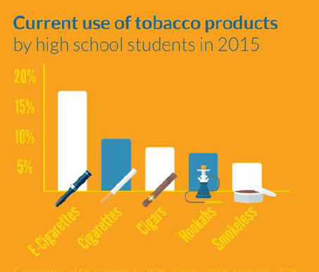
What Tobacco Products are Students Using in the U.S.?
SOURCE: CDC, Youth Risk Behavior Survey, 2015 results.
Notes:
**ANIMATION INSTRUCTIONS**
The first image is animated to appear automatically; once you review the data contained on the first image, click to advance forward . The first image will disappear, and the second image will appear.
While cigarette smoking has declined among U.S. youth in recent years, the use of some other tobacco products has increased. The images on this slide detail YRBS data focused on the number of tobacco products middle and high school students used currently, and the percentage of students self reporting the use of various tobacco products.
Additional Information for the Trainer(s):
Cigarettes: from 2011 to 2015, current cigarette smoking declined among middle and high school students. About 2 of every 100 middle school students (2.3%) reported in 2015 that they smoked cigarettes in the past 30 days (a decrease from 4.3% in 2011. About 9 of every 100 high school students (9.3%) reported in 2015 that they smoked cigarettes in the past 30 days (a decrease from 15.8% in 2011).
Electronic cigarettes: Current use of electronic cigarettes increased among middle and high school students from 2011 to 2015. About 5 of every 100 middle school students (5.3%) reported in 2015 that they used electronic cigarettes in the past 30 days (an increase from 0.6% in 2011). Sixteen of every 100 high school students (16.0%) reported in 2015 that they used electronic cigarettes in the past 30 days (an increase from 1.5% in 2011).
Hookahs: From 2011 to 2015, current use of hookahs increased among middle and high school students. Two of every 100 middle school students (2.0%) reported in 2015 that they had used hookah in the past 30 days (an increase from 1.0% in 2011). About 7 of every 100 high school students (7.2%) reported in 2015 that they had used hookah in the past 30 days (an increase from 4.1% in 2011).

Slide 67
Factors Associated with Youth Tobacco Use
Social and physical environments
Biological and genetic factors
Mental health
Personal perceptions
Other factors
SOURCE: CDC, 2016.
Notes:
A variety of factors impact youth tobacco use. With regards to social and physical environments, the way mass media show tobacco use as a normal activity can promote smoking among young people. Youth are more likely to use tobacco if they see that tobacco use is acceptable or normal among their peers. High school athletes are more likely to use smokeless tobacco than their peers who are non-athletes. Parental smoking may promote smoking among young people. With regards to biological and genetic factors, evidence exists that youth may be sensitive to nicotine and that teens can feel dependent on nicotine sooner than adults. Genetic factors may make quitting smoking more difficult for young people. A mother’s smoking during pregnancy may increase the likelihood that her offspring will become regular smokers. With regards to mental health, a strong relationship exists between youth smoking and depression, anxiety, and stress. With regards to personal perceptions, expectations of positive outcomes from smoking, such as coping with stress and controlling weight, are related to youth tobacco use. Other influences that affect youth tobacco use include: lower socioeconomic status, including lower income or education; lack of skills to resist influences to tobacco use; lack of support or involvement from parents; accessibility, availability, and price of tobacco products; low levels of academic achievement; low self-image or self-esteem; and exposure to tobacco advertising.
Image Credit: CDC website, 2016.

Slide 68
Perceived Risks and Benefits of Conventional Cigarettes vs. E-Cigarettes
“Oh, e-cigarettes are classy, because you can walk around with them. They do not have any vapor that goes around and they look nice. It’s really hyped up, like, ‘No nicotine.’ That’s what everybody’s saying. ‘There’s no nicotine.’ ‘It’s good for you. Cuz it’s vapor.’ The water vapor.”
Participants were generally unsure about the possible risks of using e-cigarettes
Participants described e-cigarettes as brand new products that they knew little about
SOURCE: Roditis & Halpern-Felsher, 2015.
Notes:
Teenagers are very familiar with the risks of smoking cigarettes, but are much less sure whether marijuana or e-cigarettes are harmful, according to a 2015 study by Roditis and Halpern-Felsher from Stanford University School of Medicine. While adolescents get clear messages from their families, teachers, peers and the media about the harms of smoking cigarettes, they receive conflicting or sparse information about the harms of marijuana and e-cigarettes. In the qualitative study, Roditis and Halpern-Felsher compared teens’ knowledge of cigarettes, e-cigarettes, and marijuana. The participants were able to describe the negative consequences of using conventional cigarettes, but were less sure of the risks of marijuana and e-cigarette use. Adolescents reported learning about e-cigarettes from the media, family and friends, and from the school environment. This small study highlights the need for clinicians, prevention campaigns, and interventions to explicitly address risks of marijuana and e-cigarettes use along with risks of cigarette use. Additionally, there needs to be a stronger connection between formal messages that adolescents are getting regarding the risks of these products and their daily experiences.
REFERENCE: Roditis, M.L., & Halpern-Felsher, B. (2015). Adolescents’ perceptions of risks and benefits of conventional cigarettes, e-cigarettes, and marijuana: A qualitative analysis. Journal of Adolescent Health, 57, 179-185.

Slide 69
Government Regulation of E-Cigarettes
U.S. Food and Drug Administration (FDA) has established a new rule for e-cigarettes and their liquid solutions
Now subject to government regulation as tobacco products
In-store and online purchasers be at least 18 years of age
More information available at: www.fda.gov/NewsEvents/Newsroom/PressAnnouncements/ucm499234.htm
SOURCE: NIDA, 2016.
Notes:
In an effort to help protect the public from the dangers of tobacco use, the U.S. Food and Drug Administration (FDA) has established a new rule for e-cigarettes and their liquid solutions. Because e-cigarettes contain nicotine derived from tobacco, they are now subject to government regulation as tobacco products, including the requirement that both in-store and online purchasers be at least 18 years of age.
REFERENCE:
National Institute on Drug Abuse. (2016). Electronic Cigarettes (E-Cigarettes) Drug Facts. Accessed May 16, 2016 from: https://www.drugabuse.gov/publications/drugfacts/electronic-cigarettes-e-cigarettes.

Slide 70
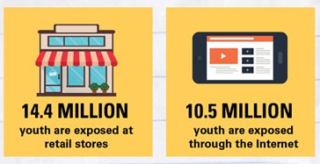
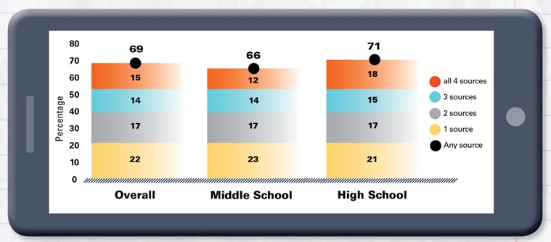
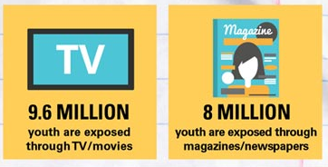
Sources of E-Cigarette Advertisement Exposure
SOURCE: CDC, 2016.
Notes:
**ANIMATION INSTRUCTIONS**
The three images are animated to appear automatically, no need to click to advance forward.
According to the 2014 National Youth Tobacco Survey, young people are exposed to e-cigarette advertisements from multiple sources. Starting with the images that appear on the left side of the slide, youth are most likely to be exposed to advertising in retail stores (14.4 million), followed by the Internet (10.5 million), TV/movies (9.6 million), and magazines or newspapers (8 million). The image on the right side of the slide pertains to the age breakdown of young people who are exposed to e-cigarette advertisements. Overall, a high proportion of U.S. middle and high school students saw e-cigarette advertisements in 2014. More specifically, 66% of U.S. middle school students, 71% of U.S. high school students, and 69% U.S. middle and high school students overall said they saw e-cigarette advertisements from one or more of the following four sources: retail, Internet, TV/movies, and Magazines/newspapers. According to additional data not shown on this slide, e-cigarette use has increased considerably among young people in the United States in recent years, and this increase corresponds to e-cigarette advertising expenditures.
REFERENCE:
Centers for Disease Control and Prevention. (2015). 2014 National Youth Tobacco Survey (NYTS). Accessed May 16, 2016 from: http://www.cdc.gov/tobacco/data_statistics/surveys/nyts/.

Slide 71
E-Cigarettes and Smoking Cessation in the Real World
Meta-analysis examined the association between e-cigarette use and cigarette smoking cessation among adults
Odds of quitting cigarettes were 28% lower among smokers who used e-cigarettes than those who did not use e-cigarettes
Take-Home Message: E-cigarettes are associated with significantly less quitting among smokers
SOURCE: Kalkhoran & Glantz, 2016.
Notes:
Kalkhoran and Glantz conducted a meta-analysis to examine the association between e-cigarette use and cigarette smoking cessation among adults. The odds of smoking cessation among smokers using e-cigarettes were compared with smokers not using e-cigarettes. The main findings, which were based on 38 studies, were that the odds of quitting cigarettes were 28% lower among those who used e-cigarettes compared with those who did not. The association of e-cigarette with quitting did not differ among studies in which all smokers used e-cigarettes vs those studies of smokers interested in cigarette cessation. Other study characteristics, such as design, population, comparison group, time of exposure assessment, etc., were not associated with the overall effect size. The researchers concluded that e-cigarettes are associated with significantly less quitting among smokers.
REFERENCE:
Kalkhoran, S., & Glantz, S.A. (2016). E-cigarettes and smoking cessation in real-world and clinical settings: A systematic review and meta-analysis. The Lancet, 4(2), 116-128.

Slide 72
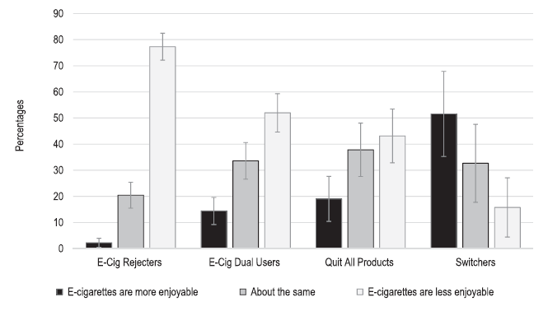
Experience of Using E-Cigarettes vs. Regular Cigarettes
The potential of e-cigarettes to replace regular cigarettes remains uncertain
SOURCE: Pechacek et al., 2016.
Notes:
**ANIMATION INSTRUCTIONS**
Two animations are included on this; once you review the main data presented in the bar graph, click once to advance to a box that appears over the “switchers” portion of the graph, and then click to advance one more time to text included at the top of the bar graph appears.
A 2016 article by Pechacek and colleagues details select results from the 2014 Tobacco Products and Risk Perception Survey. The Survey provided representative estimates of non-institutionalized US adults and included detailed data on the use of Electronic Nicotine Delivery Systems (ENDS) (a.k.a., e-cigarettes). Data were gathered from a national probability sample of 5,717 US adults. The graph depicted on this slide shows the differences in opinions about how research participants compare the experience of using e-cigarettes to smoking regular cigarettes among four study groups (e-cigarette rejecters, e-cigarette and regular cigarette dual users, individuals who quit using all smoking products, and former smokers who switched to e-cigarettes). Few e-cigarette rejecters, e-cigarette dual users, or quitters reported that e-cigarettes were more enjoyable than regular cigarettes. On the contrary, almost all switchers reported that e-cigarettes were either more enjoyable or as enjoyable as regular cigarettes. The researchers concluded that since many current smokers who have tried e-cigarettes did not find them to be a satisfying alternative to regular cigarettes, e-cigarettes are not likely to replace regular cigarettes unless the experience of using e-cigarettes is improved.
REFERENCE:
Pechacek, T.F., Nayak, P., Gregory, K.R., Weaver, S.R., & Eriksen, M.P. (2016). The potential that electronic delivery systems can be a disruptive technology: Results from a national survey. Nicotine and Tobacco Research, 00(00), 1-9.

Slide 73
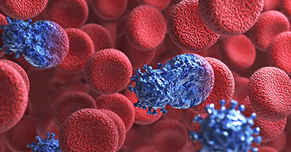
Smoking and HIV: What’s the Connection?
Notes:
TRANSITION SLIDE
The next section of the presentation prevents information on the connection between smoking and HIV acquisition and disease progression.
Image Credit: CDC website, 2016.

Slide 74
Test Your Knowledge
The prevalence of smoking is _____ among Americans living with HIV than in the general US population.
About the same
Two to three times higher
Five times higher
Ten times higher
Notes:
ANSWER KEY
The correct response is B (Two to three times higher)

Slide 75
Smoking among People Living with HIV/AIDS
Prevalence of smoking is approximately 2-3x higher than in the general population
Perceived to have little interest in and motivation for smoking cessation efforts
For people infected with HIV, smoking has been associated with increased rates of many negative health outcomes
SOURCE: Los Angeles County Department of Health Services, Tobacco Control and Prevention Program.
Notes:
People living with AIDS are often perceived to have little interest in and motivation for smoking cessation efforts due to a poor outlook for their future and a belief that death from AIDS is the inevitable outcome of their HIV diagnosis. As HIV infection transforms from a terminal illness into a manageable, chronic condition, however, a stronger emphasis should be placed on smoking cessation efforts with the goal of improving quality of life.
Among people who are infected with HIV, the prevalence of smoking is higher than it is in the general population. For example, according to one East Coast study (2000), people living with HIV had a smoking prevalence of 70%, as compared to a national prevalence of 25%. In another study based in San Francisco (2002), people with HIV had a smoking prevalence of 54%, compared to a prevalence estimate of 18% for the general population in San Francisco and the state of California.
For people infected with HIV, smoking has been associated with increased rates of a variety of negative health outcomes, as stated on the next slide.
REFERENCE:
Los Angeles Department of Health Services, Tobacco Control and Prevention Program. HIV and Tobacco Use. Accessed April 27, 2016 from http://publichealth.lacounty.gov/tob/pdf/HIV%20Flyer.rev.pdf.

Slide 76
How might Smoking affect HIV Disease Progression?
Less successful HIV drug therapy
May be more likely to experience side effects of HIV medications
Lower CD4 counts
May have greater chance of developing opportunistic infections
Higher rates of HIV transmission
SOURCE: The Body, accessed April 27, 2016.
Notes:
Cigarette smoking is a dangerous habit even for those in perfect health. The risks involved with smoking seem to be greater, however, for people who are living with HIV. Recent research has shown that, for people living with HIV and receiving good medical care, those who smoke lose more years of their life to smoking than to HIV. In the past, many people living with HIV did not worry about the serious illnesses that smoking might cause because they did not expect to be alive long enough to get them. Now that people living with HIV are living longer, healthier lives, it is critical to pay attention to issues that affect long-term health and wellness.
REFERENCE:
The Body. Smoking, Tobacco Use, and HIV. Accessed April 27, 2016 from: http://www.thebody.com/content/62098/smoking-tobacco-use-and-hiv.html.

Slide 77
What Does the Research Say?
Outcome | Citation | Finding
HIV acquisition | Burns et al., 1991 | Higher % of seroconversion among cigarette smokers (p=0.03)
HIV progression | Royce & Winkelstein, 1990 Feldman et al., 2006 | Significant CD4 cell decline (p<0.01) (2) Significant CD4 cell decline (p=0.01) and significant difference in incidence of AIDS-defining conditions (p<0.01)
HIV progression | Nieman et al., 1993 | Shorter median time to AIDS (shorter for smokers; p=0.03)
All-Cause Mortality | Crothers et al., 2005 (2) Feldman et al., 2006 | Significant effect of smoking on mortality (HR=1.99) (2) Significant effect of smoking on mortality (HR=1.53)
SOURCE: Marshall et al., 2009.
Notes:
Cigarette smoking is more common among those with HIV compared the general population. According to a literature review by Marshall and colleagues (2009), “it remains unclear whether smoking alters the natural history of HIV infection or if unique health consequences related to smoking occur in the context of HIV.” This slide features key positive findings from the Marshall et al. literature review. According to the research team, more data are needed regarding the prevalence, patterns, and intensity of cigarette smoking within HIV-infected and at risk populations. And longitudinal studies will be important to identify trajectories of smoking over time and in particular, what changes occur in smoking behavior in relation to HIV seroconversion, HAART initiation, or changes in use of illicit substances.
HR = hazard ratio (in survival analysis, the hazard ratio is the ratio of the hazard rates corresponding to the conditions described by two levels of an explanatory variable; in this case it’s the rate of death between people with HIV who smoke vs. people with HIV who do not smoke).
Importantly, both studies demonstrating a significant effect of smoking on mortality included follow-up almost entirely during the time period in which highly active anti-retroviral therapy (HAART) was the standard of care (Crothers et al., 1993 and Feldman et al., 2006).
REFERENCE:
Marshall, M.M., McCormack, M.C., & Kirk, G.D. (2009). Effect of cigarette smoking on HIV acquisition, progression, and mortality. AIDS Education and Prevention, 21(3 Suppl), 28-39.

Slide 78
HIV Infection, Cigarette Smoking, and CD4 Counts
According to results of the San Francisco Men’s Health Study:
Smokers’ counts fell faster than non-smokers’ following HIV infection
Response to smoking is less pronounced soon after infection
SOURCE: Royce & Winkelstein, 1990.
Notes:
The effect of cigarette smoking on CD4+ T lymphocytes was investigated in the San Francisco Men's Health Study cohort. The cohort was established by probability sampling in 1984 to study infection with HIV. Smoking showed an association with increased CD4+ cell counts in all men but the effect was attenuated in HIV-seropositive men (85 cells/[mu]l difference in median counts, non-smokers compared with smokers) compared with HIV-seronegative men (230 cells/[mu]l difference in median counts). The positive dose response between packs smoked per day and CD4+ counts observed in uninfected men was substantially reduced in infected men (slope 87 versus 27 cells/[mu]l). Analysis of data from HIV seroconverters suggest that smokers' counts fall faster than non-smokers' following infection, and that response to smoking becomes less pronounced soon after infection. This report demonstrates that those who monitor CD4+ cell counts in HIV-infected individuals for clinical and/or research purposes should also consider smoking status.
REFERENCE:
Royce, R., & Winkelstein, Jr., W. (1990). HIV infection, cigarette smoking, and CD4+ T-lymphocyte counts: Preliminary results from the San Francisco Men’s Health Study. AIDS, 4(4), 327-333.

Slide 79
Consequences of Smoking for People Living with HIV
Periodontal disease
Oral candidiasis
Oral hairy leukoplakia
Oral lesions
Bacterial pneumonia
AIDS-related spontaneous pneumothorax
Karposi’s sarcoma
Cervical cancer
Lung cancer
Genital warts
AIDS dementia complex
Emphysema
Bronchial hyperresponsiveness
Bronchitis
Depression
SOURCE: Los Angeles County Department of Health Services, Tobacco Control and Prevention Program.
Notes:
Smoking is associated with increased rates of a variety of negative health outcomes. Smoking when you have HIV makes you more likely to get other serious illnesses than non-smokers with HIV. They include: COPD (chronic obstructive pulmonary disease, a serious lung disease that causes severe breathing problems and includes emphysema and chronic bronchitis), health disease and stroke, lung cancer, head and neck cancer, cervical cancer, and anal cancer. People with HIV who smoke are less likely to maintain their HIV treatment plan than non-smoking HIV patients.
Oral candidiasis = also called thrush; a mouth infection
Hairy leukoplakia = white mouth sores
REFERENCE:
Los Angeles Department of Health Services, Tobacco Control and Prevention Program. HIV and Tobacco Use. Accessed April 27, 2016 from http://publichealth.lacounty.gov/tob/pdf/HIV%20Flyer.rev.pdf.

Slide 80
“Cigarette smoking is the most important modifiable cardiovascular risk factor among HIV-infected patients.”
“Cessation of smoking is more likely to reduce cardiovascular risk than either the choice of antiretroviral therapy or the use of any lipid-lowering therapy.”
SOURCE: Grinspoon & Carr, 2005.
Notes:
According to research by Grinspoon and Carr (2005), cigarette smoking is the most important modifiable cardiovascular risk factor among HIV-infected patients.
REFERENCE:
Grinspoon, S., & Carr, A. (2005). Cardiovascular risk and body-fat abnormalities in HIV-infected individuals. New England Journal of Medicine, 352(1), 48-62.

Slide 81
Consequences of Smoking for People Living with HIV
For pregnant women infected with HIV, research has shown a threefold increase in the risk of transmitting HIV to their child due to smoking
Some research has pointed to a more rapid progression to AIDS and a higher risk of death in smokers infected with HIV
Smokers who are HIV+ who undergo HAART could be predisposed to an even higher risk of cardiovascular disease than for smoking alone
SOURCE: Los Angeles County Department of Health Services, Tobacco Control and Prevention Program.
Notes:
Many consequences exist for people living with HIV who smoke, including those related to transmission during pregnancy, more rapid progression to AIDS, higher risk of cardiovascular disease, and higher risk of death.
REFERENCE:
Los Angeles Department of Health Services, Tobacco Control and Prevention Program. HIV and Tobacco Use. Accessed April 27, 2016 from http://publichealth.lacounty.gov/tob/pdf/HIV%20Flyer.rev.pdf.

Slide 82
Barriers to Smoking Cessation among Individuals Living with HIV
HIV care providers less likely to identify current smokers and report less confidence in influencing smoking cessation than non-HIV care providers
Managing complications of HIV infection may overshadow smoking cessation discussions
Smoking cessation is less of a priority, if the individual feels he/she will die from AIDS
May use tobacco to manage HIV-related symptoms and pain
Body image issues/body mass index increases
High prevalence of concomitant substance use
SOURCE: Rahmanian et al., 2011.
Notes:
In their 2011 review article, Rahmanian and colleagues outlined a variety of potential barriers and complicating factors to smoking cessation among individuals infected with HIV. Additional barriers not included in the bulleted list are as follows: high prevalence of psychiatric disorders in HIV-infected individuals (between 17 and 63%, depending on the study); low socioeconomic status and lack of strong support systems (lower income and employment status appear to be associated with smoking in HIV-infected individuals.
REFERENCE:
Rahmanian, S., Wewers, M.E., Koletar, S., Reynolds, N., Ferketich, A., & Diaz, P. (2011). Cigarette smoking in the HIV-infected population. Proceedings of the American Thoracic Society, 8(3), 313-319.

Slide 83
Desire to Quit Smoking among People Living with HIV
SOURCE: Mamary et al., 2002.
Notes:
Mamary and colleagues studied the desire to quit smoking among individuals living with HIV. The results were encouraging in that nearly three-quarters of the study participants had previously tried to quit smoking, and nearly two-thirds were currently thinking about quitting. Of those currently thinking about quitting, high percentages were interested in smoking cessation group counseling programs, nicotine replacement therapy, or a combination of both.
Health care settings are important venues for smoking cessation efforts with persons living with HIV. Because of an increased use of medical services, people living with HIV have greater contact with health care professionals who can assess them for smoking and provide referrals to smoking cessation services, if warranted.
REFERENCE:
Mamary et al., (2002). Cigarette smoking and the desire to quit among individuals living with HIV. AIDS Patient Care and STDs, 16, 39-42.

Slide 84
Case Study: Brian
Brian, age 43, was admitted into the hospital after being diagnosed with HIV. Soon thereafter, his virus became undetectable. He went back to work and began to feel “invincible.” Quitting his 30-year smoking habit was hardly a priority, until he started to experience increasingly serious health issues. You are meeting Brian for the first time.
Where would you start the conversation with Brian?
Recognizing that Brian gets to set his treatment goals, what are the top three priority issues to discuss?
SOURCE: CDC, 2016.
Notes:
INSTRUCTIONS
Read the case study aloud.
Ask participants to break into pairs or small groups (depending on the size of the audience), and spend 5-10 minutes discussing the two questions.
De-brief as a full group for 5-10 minutes. Ask for volunteers to briefly share responses to the two questions.

Slide 85
Let’s Hear from Brian
SOURCE: CDC, 2016.
Notes:
INSTRUCTIONS
This slide contains a movie clip that will play when the trainer clicks on the box. In order for this to work, the connection between the PowerPoint
presentation and the video file must be maintained. When moving the PowerPoint file to another location on your computer or to another computer,
make sure to always move the video file along with it. If the link becomes broken, the video will need to be reinserted. Delete the black box that
appears on the slide. From the insert menu in PowerPoint, select “movie.” Select the video file that was included for this training. When asked,
indicate that the movie should play automatically. It will appear as a black box on the screen. Move the black box on the slide and it should play
when the slide show is being viewed when the trainer clicks on the box.
Brian is featured in the CDC’s A Tip from a Former Smoker Campaign. According to Brian, HIV alone did not cause the clogged artery in my neck. Smoking with HIV did. Brian was in good health, working and managing his infection with HIV—the virus that can cause AIDS—when smoking led to health problems that nearly killed him. Smoking is especially dangerous for people who are living with HIV. For Brian, smoking and having HIV led to clogged blood vessels. At age 43, he had a blood clot in his lungs, a stroke, and surgery on an artery in his neck. Brian had already beat tough health problems—including being very sick with AIDS—but he had not quit smoking. "It took a stroke for me to actually stop smoking," said Brian. For months after the stroke, Brian had trouble speaking and reading. He couldn't work or even dress himself. Today, his right hand is still weak, so he can no longer work as a waiter or teach pottery classes. Brian hopes his story will inspire other people to quit smoking before it's too late. "Smoking is something that you do have control over. You can stop. And it's worth your life to stop smoking."
Link to Brian’s Story: http://www.cdc.gov/tobacco/campaign/tips/stories/brian.html.

Slide 86
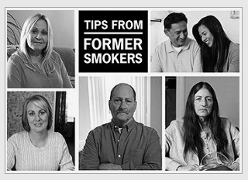
Effective Medical and Behavioral Smoking Cessation Approaches
Notes:
TRANSITION SLIDE
The final section of this presentation reviews the medical and behavioral smoking cessation approaches available today.

Slide 87
Short- and Long-Term Benefits of Quitting Smoking
2-5 years: Risk of certain cancers is halved
2 weeks-3 months: Lung function begins to improve
1 Year: Added risk of coronary heart disease is half that of a smoker
20 minutes: Heart rate drops
10 years: Lung cancer death rate is half that of smoker
Last cigarette
X
TIME
15 years: Risk of coronary heart disease is back to that of a non-smoker
2 weeks-3 months: Heart attack risk begins to drop
12 hours: Carbon monoxide in blood drops to normal
1 to 9 months: Coughing and shortness of breath decrease
2-5 years: Stroke is reduced to that of a non-smoker’s
Notes:
**ANIMATION INSTRUCTIONS**
This slide contains a series of animated text boxes. You do not need to click to advance to the next animation, each will appear automatically every few seconds.
It does not matter how long you have been smoking; quitting can greatly improve your overall health and wellness, in as little as 20 minutes. Within 20 minutes of smoking the last cigarette, your body begins a series of changes that continue for years. Within 24 hours, your blood pressure drops, and your risk of heart attack begins to decrease. Within months, you can have better lung function and circulation. Over several years, you can greatly reduce your risk of lung cancer and heart disease. People who quit at the age of 50 are half as likely to die of smoking-related causes than those who continue to smoke.
REFERENCES:
Centers for Disease Control and Prevention. (2016). Benefits of Quitting. Accessed April 27, 2016 from http://www.cdc.gov/tobacco/quit_smoking/how_to_quit/benefits/index.htm.
The Body. Smoking, Tobacco Use, and HIV. Accessed April 27, 2016 from: http://www.thebody.com/content/62098/smoking-tobacco-use-and-hiv.html.

Slide 88
Additional Benefits of Quitting Smoking or Going Tobacco-Free
Improved sense of smell and taste
Healthier looking skin
Whiter teeth
Healthier gums
Fresher breath
Able to participate in physical activities
Economic savings
No more smoking ban restrictions
SOURCE: The Body: The Complete HIV/AIDS Resource, accessed April 27, 2016
Notes:
Quitting smoking or going tobacco-free has other health benefits, in addition to the ones described on the previous slide.
REFERENCE:
The Body. Smoking, Tobacco Use, and HIV. Accessed April 27, 2016 from: http://www.thebody.com/content/62098/smoking-tobacco-use-and-hiv.html.

Slide 89
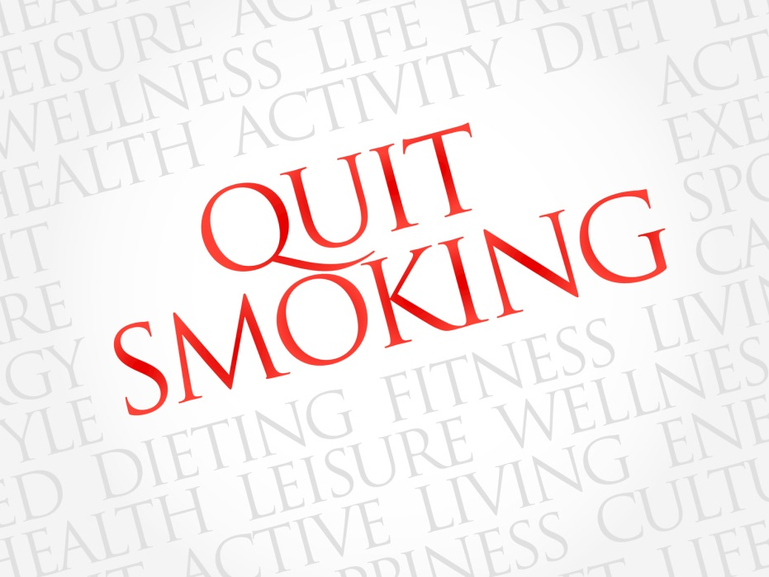
What are the Main Types of Smoking Cessation Approaches?
Nicotine Replacement Therapies
Patch, spray, gum, lozenges
Other Medications
Bupropion (Zyban®)
Varenicline (Chantix®)
Behavioral Treatments
Quitlines
SOURCES: NIDA, 2016; The Body: The Complete HIV/AIDS Resource, accessed April 27, 2016
Notes:
Several forms of nicotine replacement therapies exist, including transdermal patches (Habitrol, Nicoderm, Nicotrol), nasal spray, gum (Nicorette), inhaler, and lozenges (Commit). These products are available over the counter. The U.S. Food and Drug Administration (FDA) has approved two prescription medications for nicotine addiction: bupropion (Zyban®) and varenicline (Chantix®). They work differently in the brain, but both help prevent relapse in people trying to quit. The medications are more effective when combined with behavioral treatments, such as group and individual therapy, as well as the use of telephone quitlines. Lastly, clinicians can use the “5As” (Ask, Advise, Assess, Assist, Arrange) or the “AAR” (Ask, Advise, Refer) to engage in a conversation with patients about their smoking status and willingness to quit.
Transdermal patches are worn on the arm or torso, and nicotine is absorbed through the skin. With gum, nicotine is absorbed through the lining of the mouth (dose depends on amount of tobacco used). Lozenges are hard candy that is sucked slowly and absorbed through the lining of the mouth. With an inhaler, a puff from the inhaler puts nicotine into a vapor that is absorbed in the mouth; this method is most like smoking a cigarette. Nasal sprays spray nicotine into the nostrils, and is available by prescription only.
Bupropion reduces the urge to smoke and is available by prescription only. It is also available as an anti-depressant (Wellbutrin) at a different dose. Varenicline reduces withdrawal symptoms and the pleasure associated with smoking; it, too, is available by prescription only.
REFERENCES:
National Institute on Drug Abuse. (2016). Treatment Approaches for Drug Addiction. Accessed May 19, 2016 from https://www.drugabuse.gov/publications/drugfacts/treatment-approaches-drug-addiction.
The Body. Smoking, Tobacco Use, and HIV. Accessed April 27, 2016 from: http://www.thebody.com/content/62098/smoking-tobacco-use-and-hiv.html.

Slide 90
Other Types of Smoking Cessation Approaches
Acupuncture
Hypnosis
Counseling and support
SOURCE: The Body: The Complete HIV/AIDS Resource, accessed April 27, 2016
Notes:
Acupuncture is a complementary therapy that involves placing very small needles around the outer ear to reduce cravings and promote relaxation. Hypnosis (or hypnotherapy) involves reaching a state of deep relaxation in which one is open to suggestions for behavioral change (such as quitting smoking). Many people may find it helpful to have professional counseling or the organized support of others when quitting. Many places have organized support groups and smoking cessation classes (in the US, see your local chapter of the American Lung Association or American Cancer Society).
REFERENCE: The Body. Smoking, Tobacco Use, and HIV. Accessed April 27, 2016 from: http://www.thebody.com/content/62098/smoking-tobacco-use-and-hiv.html.

Slide 91
Quitlines and Behavioral Health
Do quitlines work for people with MI and/or SUD?
Yes!
Are they able to meet the demand? They are underused
SOURCE: Slide courtesy of Steven A. Schroeder, MD, 2015.
Notes:
Quitlines have been established to help people quit smoking. This slide featues one such quitline.
REFERENCE: Schroeder, S.A. (2015). Get Your Patients with HIV/AIDS to Stop Smoking Before it Kills Them. Presented at the International Antiviral Society Meeting, December 15-17, 2015, New Orleans, LA.

Slide 92
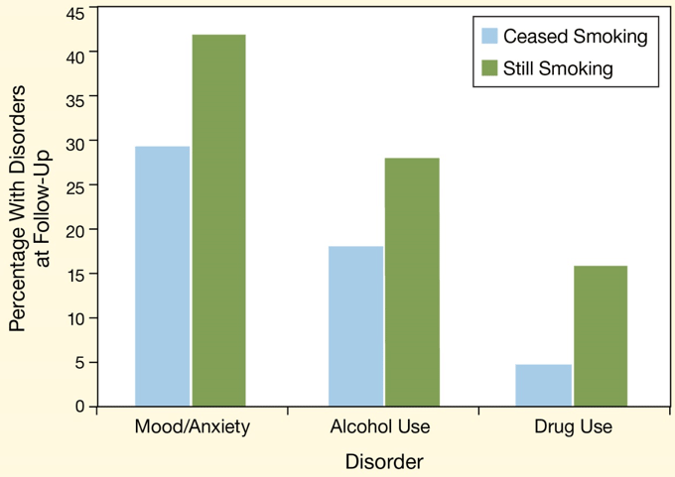
Smoking Cessation Linked to Reduced Prevalence of Substance Use and Mental Health Disorders
SOURCE: NIDA, 2016; Cavazos-Regh et al., 2014.
Notes:
Smoking cessation appears unlikely to hinder and may even help recovery from substance use disorders and from mood and anxiety disorders, according to research led by Dr. Patricia Cavazos-Rehg at the Washington University School of Medicine in St. Louis, Missouri. Cavazos-Rehg and colleagues examined responses of more than 5,000 daily smokers who completed the National Epidemiological Survey on Alcohol and Related Conditions (NESARC). Between two interviews (one conducted in 2001-2002 and a follow-up interview conducted three years later), nearly 60% of respondents cut back on smoking by 10% or more, including nearly 20% who quit altogether. Quitters reported fewer continuing or recurrent drug use disorders (by 69%), alcohol use disorders (by 36%), and mood or anxiety disorders (by 30%) at follow-up. The Missouri team's findings are consistent with those of other studies, and strongly argue that smoking cessation is highly compatible with recovery from mental disorders.
REFERENCES:
National Institute on Drug Abuse. Smoking Cessation Does Not Interfere with Recovery from Substance Abuse. Accessed August 26, 2016 from https://www.drugabuse.gov/news-events/nida-notes/2014/10/smoking-cessation-does-not-interfere-recovery-substance-use.
Cavazos-Rehg, P.A., Breslau, N., Hatsukami, D., et al. (2014). Smoking cessation is associated with lower rates of mood/anxiety and alcohol use disorders. Psychological Medicine, 44(12), 2523-2535.

Slide 93
What Can You Do?
Referral patients to the quitline
1-800-QUITNOW
Purchase a carbon monoxide breathalyzer
Costs about $500 plus disposal mouthpieces
Ask all patients this question:
“When do you have your first cigarette of the day?”
Approach smoking as a chronic illness, just like HIV/AIDS
Notes:
This slide features a bulleted list of things that providers can consider to assist patients who wish to quit smoking.

Slide 94
Cognitive Strategies for Smoking Cessation
Review commitment to quit
Focus on downsides of tobacco use
Reframe smoking thoughts
Distractive thinking
Positive self-talks, “pep talks”
Relaxation through imagery
Mental rehearsal, visualization
SOURCE: Slide courtesy of Steven A. Schroeder, MD, 2015.
Notes:
Cognitive strategies focus on retraining the way a patient thinks. Many quitters panic because they are thinking about tobacco after they quit, and this leads to relapse. Thinking about cigarettes (or other forms of tobacco) is normal. The trick is not to dwell on the thought. As tobacco users move toward sustained abstinence, they learn to recognize that thinking about a cigarette doesn’t mean they need to have one.
One cognitive strategy that might help is reviewing one’s commitment to quitting, including reminding oneself that cravings and temptations are temporary and will pass. Sometimes it helps a patient to announce, either silently or out loud, “I want to be a nonsmoker, and the temptation will pass.” Or each morning, to look in the mirror and say, “I am proud that I made it through another day without tobacco!”
Deliberate, distractive thinking can help a patient move current thought processes to issues other than craving or temptation to use tobacco. Positive self-talks, or “pep-talks,” involve saying things such as, “I can do this,” or reminding oneself of previous difficult situations in which tobacco use was avoided successfully. Relaxation through imagery helps the patient to center the mind on positive, relaxing thoughts. This can help to ease the anxiety, stress, and negative moods that may trigger tobacco use. Mental rehearsal and visualization involves envisioning situations that might arise and how best to handle them. This method is commonly used by athletes prior to a game. For example, a goalie might envision (or enact, during pregame warmups) how to block different types of shots or plays from opposing players. In the case of smoking, a person might envision what would happen if he or she were offered a cigarette by a friend—he or she would mentally craft and rehearse a response and perhaps even practice it by saying it out loud.
Image Credit: CDC website, 2016.

Slide 95
Behavioral Strategies for Smoking Cessation
Stress
Anticipate future challenges
Develop substitutes for tobacco
Alcohol
Limit or abstain during early stages of quitting
Other tobacco users
Stay away
Ask for cooperation from family and friends
SOURCE: Slide courtesy of Steven A. Schroeder, MD, 2015.
Notes:
This slide features additional concrete strategies and techniques that can be utilized with patients to help them manage stress, alcohol intake, and the impact of other tobacco users.

Slide 96
Behavioral Strategies for Smoking Cessation
Oral gratification needs
Use substitutes: water, sugar- free gum or hard candies
Automatic smoking routines
Anticipate routines; develop alternative plan
Weight gain after cessation
Anticipate; use gum or medication; exercise
Cravings
Distractive thinking; change activities
SOURCE: Slide courtesy of Steven A. Schroeder, MD, 2015.
Notes:
This slide features additional concrete strategies and techniques that can be utilized with patients to help them focus on meeting oral gratification needs, avoid smoking routines, manage weight gain after cessation, and manage cravings.

Slide 97
More about Pharmacotherapy
“Clinicians should encourage all patients attempting to quit to use effective medications for tobacco dependence treatment, except where contraindicated or for specific populations* for which there is insufficient evidence of effectiveness.”
* Includes pregnant women, smokeless tobacco users, light smokers, and adolescents.
Medications significantly improve success rates.
SOURCES: Fiore et al., 2008; Slide courtesy of Steven A. Schroeder, MD, 2015.
Notes:
97
The U.S. Public Health Service Clinical Practice Guideline for treating tobacco use and dependence states that “clinicians should encourage all patients attempting to quit to use effective medications for tobacco dependence treatment, except where contraindicated or for specific populations for which there is insufficient evidence of effectiveness” (Fiore et al., 2008, p. 106).
Use of pharmacotherapy requires special consideration in the following patient populations (Fiore et al., 2008):
Pregnant or breast-feeding women
Smokeless tobacco users
Patients smoking fewer than 10 cigarettes per day (light smokers)
Adolescents
REFERENCE:
Fiore, M.C., Jaén, C.R., Baker, T.B., et al. (2008). Treating Tobacco Use and Dependence: 2008 Update. Clinical Practice Guideline. Rockville, MD: U.S. Department of Health and Human Services. Public Health Service.

Slide 98
Pharmacologic Methods: First-line Therapies*
Nicotine replacement therapy (NRT)
-- nicotine gum, patch, lozenge, nasal spray, inhaler
Partial nicotine receptor agonist
-- varenicline
--? cytisine in the future
Psychotropics
-- sustained-release bupropion
* Counseling plus meds better than either alone
Currently, no medications have an FDA indication for use in spit tobacco cessation.
SOURCES: Fiore et al., 2008; Hughes et al., 2007; David et al., 2006; Slide courtesy of Steven A. Schroeder, MD, 2015.
Notes:
Three general classes of FDA-approved medications exist for smoking cessation:
Nicotine replacement therapy (NRT) includes the nicotine gum, patch, lozenge, nasal spray, and inhaler. A nicotine sublingual tablet currently is available in Europe.
The only psychotropic agent currently approved by the FDA for smoking cessation is bupropion SR.
Varenicline, a partial nicotinic receptor agonist, was approved by the FDA in 2006 for smoking cessation.
According to the U.S. Public Health Service Clinical Practice Guideline for treating tobacco use and dependence, NRT, sustained-release bupropion and varenicline are considered first-line pharmacotherapies for smoking cessation (Fiore et al., 2008). Currently, no medications have an FDA indication for use in spit tobacco cessation.
Additional Information for the Trainer(s):
The following pharmacotherapies have been studied but are not recommended by the U.S. Public Health Service Clinical Practice Guideline for treating tobacco use and dependence based on a lack of benefit relative to placebo therapy (Fiore et al., 2008; Hughes et al., 2007; David et al., 2006):
Anxiolytic agents (buspirone, diazepam)
Beta-blockers (propranolol)
Mecamylamine
Opioid mixed agonists-antagonists and antagonists (buprenorphine, naloxone, naltrexone)
Selective serotonin reuptake inhibitors (citalopram, fluoxetine, paroxetine, sertraline)
Silver acetate
REFERENCES:
Fiore, M.C., Jaén, C.R., Baker, T.B., et al. (2008). Treating Tobacco Use and Dependence: 2008 Update. Clinical Practice Guideline. Rockville, MD: U.S. Department of Health and Human Services. Public Health Service.
Hughes, J.R., Stead, L.F., & Lancaster, T. (2007). Antidepressants for smoking cessation. Cochrane Database Syst Rev 1:CD000031.
David, S., Lancaster, T., Stead, L.F., & Evins, A.E. (2006). Opioid antagonists for smoking cessation. Cochrane Database Syst Rev 4:CD003086.

Slide 99
Techniques for Talking to Your Patients about Quitting Smoking
Ensure that tobacco use status is collected during clinic visits as a “vital sign”
Discuss the cost savings of quitting
Discuss how quitting can improve overall health status
Discuss secondhand smoke and how it can injure children and loved ones
SOURCE: CDC, 2016.
Notes:
The current care model and workforce for HIV infection are well-suited to address smoking cessation with patients living with HIV. This slide details a few concrete techniques HIV care providers can use to engage their patients in a conversation about quitting smoking.
REFERENCE:
Centers for Disease Control and Prevention. (2016). Smoking and HIV. Accessed April 15, 2016 from http://www.cdc.gov/tobacco/campaign/tips/diseases/smoking-and-hiv.html.
Image Credit: CDC website, 2016.
Image Credit: CDC, 2016.
Additional Resource:
HIV Clinical Resource (Smoking Cessation in HIV-Infected Patients): http://www.hivguidelines.org/clinical-guidelines/hiv-and-substance-use/smoking-cessation-in-hiv-infected-patients/.

Slide 100
The Five “A’s” for Patients Willing To Quit Smoking
Ask – identify and document tobacco use status for every patient at every visit
Advise – in a clear, strong, and personalized manner, urge every tobacco user to quit
Assess – if the tobacco user willing to make a quit attempt at this time
Assist – if yes, use counseling and pharmacotherapy to help him/her quit
Arrange – schedule follow-up contact soon after the quit date
SOURCE: AHRQ, 2016; Arnsten, n.d.
Notes:
Successful intervention begins with identifying users and appropriate interventions based upon the patient's willingness to quit. The five major steps to intervention are the "5 A's": Ask, Advise, Assess, Assist, and Arrange.
Ask every patient at every visit about tobacco use; consider it a vital sign, along with blood pressure, pulse, temperature, and respiratory rate.
Make advice clear, strong, and personalized (“As your health care provider, I must tell you that the most important thing you can do to improve your health is to stop drinking.”)
Assess – “Are you willing to try to quit at this time? I can help you.”
Assist – develop a quit plan.
Arrange to follow-up soon after quit date (“How has quitting tobacco helped you?”). The majority of relapse occurs in the first two weeks after quitting.
REFERENCES:
Agency for Healthcare Research and Quality (AHRQ). Five Major Steps to Intervention (The “5 A’s”). Accessed August 26, 2016 from http://www.ahrq.gov/professionals/clinicians-providers/guidelines-recommendations/tobacco/5steps.html.
Arnsten, J.H., (n.d.). Evidence-Based Smoking Cessation Counseling for HIV-Infected Patients. Submitted by the NY/NJ AETC.

Slide 101
Tips for Providing the Right Treatment at the Right Time
Assess where the individual is at with regards to willingness to quit smoking
Distinguish between current use, past use, and no history of use in addition to light and heavy smoker categories
Ask about all forms of present and past nicotine and tobacco use
Assess medical, psychiatric, and addiction co-morbidities and socioeconomic factors
SOURCE: Mee-Lee, 2016.
Notes:
Drs. Susan Blank and Lori Karan are the co‐authors of the Tobacco Use Disorder section of Chapter 9 "Emerging Understandings of Addiction" in The ASAM Criteria (2013). Susan Blank, MD is President of the Georgia Society of Addiction Medicine (GSAM) and Co‐Founder and Chief Medical Officer of the Atlanta Healing Center in Norcross, Georgia. Lori Karan D., MD, FACP, FASAM is Medical Director of the Department of Public Safety, and is Professor of Psychiatry, John A Burns School of Medicine, Honolulu, Hawaii. She is also an Associate Clinical Professor of Medicine, University of California, San Francisco.
This slide contains tips on “The Right Treatment at the Right Time” for nicotine addiction.
REFERENCE:
Mee-Lee, D. (2016). David Mee-Lee’s tips and topics. Volume 13, Number 10, January 2016.

Slide 102
Tips for Providing the Right Treatment at the Right Time
Assess whether the smoker is using alcohol, illicit drugs, and prescription medications
Treatment planning should be holistic, and take into account the multidimensional assessments
The intervention and intensity of treatment should be tailored to the individual
SOURCE: Mee-Lee, 2016.
Notes:
Drs. Susan Blank and Lori Karan are the co‐authors of the Tobacco Use Disorder section of Chapter 9 "Emerging Understandings of Addiction" in The ASAM Criteria (2013). Susan Blank, MD is President of the Georgia Society of Addiction Medicine (GSAM) and Co‐Founder and Chief Medical Officer of the Atlanta Healing Center in Norcross, Georgia. Lori Karan D., MD, FACP, FASAM is Medical Director of the Department of Public Safety, and is Professor of Psychiatry, John A Burns School of Medicine, Honolulu, Hawaii. She is also an Associate Clinical Professor of Medicine, University of California, San Francisco.
This slide contains tips on “The Right Treatment at the Right Time” for nicotine addiction.
REFERENCE:
Mee-Lee, D. (2016). David Mee-Lee’s tips and topics. Volume 13, Number 10, January 2016.

Slide 103
A Few Caveats…
Smoking is a chronic condition, yet medication treatment often short (12 weeks) in contrast to methadone maintenance
Great spectrum of severity and addiction; treatment should be tailored accordingly
Study participants may be more motivated to quit
Research tends to involve more intensive counseling than what is found in real-world practice
Most medication trials exclude patients with mental illness
SOURCE: Slide courtesy of Steven A. Schroeder, MD, 2015.
Notes:
It is important to keep in mind that smoking is a chronic condition, yet treatment approaches that involve the use of medicines are often short in duration. It is essential that treatment be tailored to the severity of the patient’s addiction. With regards to results from research trials, it may be the case that study participants are more motivated to quit than those individuals who do not participate in research studies. Lastly, there are limitations to the individuals who are selected to participate in research trials.

Slide 104
Strategies to Prevent Smoking among Youth
Higher costs for tobacco products
Prohibiting smoking in indoor areas of worksites and public places
Raising the minimum age of sale to 21 years
TV and radio commercials, posters, and other media messages to counter tobacco product ads
Community programs and school and college policies to encourage tobacco-free environments
Community programs that reduce tobacco advertising, promotions, and availability of tobacco products
SOURCE: CDC, 2016.
Notes:
A variety of national, state, and local program activities have been shown to reduce and prevent youth tobacco use when implemented together, and are referenced in the bulleted list.

Slide 105
Resources for Clinicians
California Youth Advocacy Network (www.cyanonline.org)
California Smokers’ Helpline (www.nobutts.org)
California Tobacco Control Program (http://www.cdph.ca.gov/programs/Tobacco)
Smoking Cessation Leadership Center (http://smokingcessationleadership.ucsf.edu)
Los Angeles County Tobacco Control and Prevention Program (http://www.lapublichealth.org/tob)
Notes:
The California Youth Advocacy Network changes the tobacco use culture in California’s high schools, colleges, and universities, military installations, and other youth and young adult communities by providing knowledge, skills, and tools to create local change for healthier communities. CYAN offers technical assistance, training, statewide advocacy and policy campaigns, educational materials and publications, and opportunities for networking.
The California Smokers’ Helpline offers free telephone counseling, self-help materials, and online help in six languages to help individuals quit smoking. Additional information is available by calling 1-800-NO-BUTTS (1-800-662-8887).
The mission of the California Tobacco Control Program is to improve the health of all Californians by reducing illness and premature death attributable to the use of tobacco products. Through leadership, experience, and research, CTCP empowers statewide and local health agencies to promote health and quality of life by advocating social norms that create a tobacco-free environment.
The Smoking Cessation Leadership Center is based at the University of California, San Francisco, and provides CME/CE webinars, fact sheets, toolkits, and publications, training resources and presentations, e-newsletters and listserv, and online ordering options for 1-800-QUIT NOW cards.
The Los Angeles County Department of Public Health's Tobacco Control and Prevention Program (TCPP) is the largest local lead agency in California in terms of size and funding. TCPP implements a countywide program to reduce youth access to tobacco product, reduce exposure to secondhand smoke and increase access to smoking cessation services.
NOTE: This slide can be customized by trainers who will be presenting the information outside of California.

Slide 106
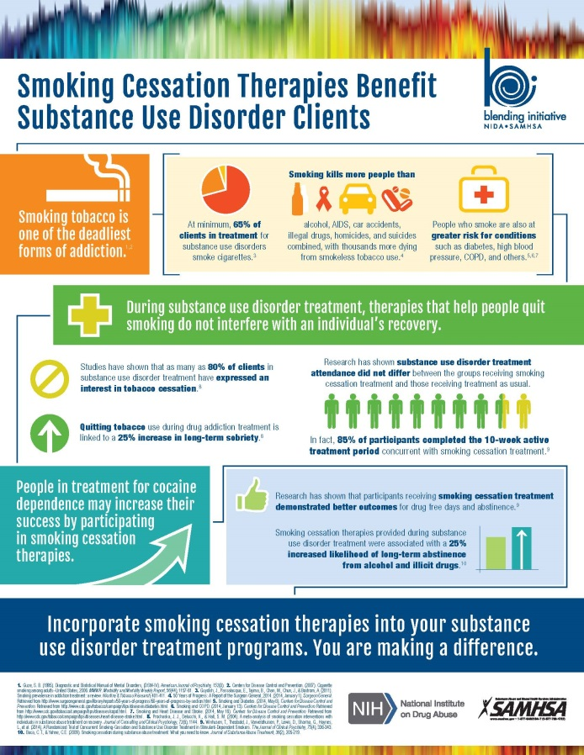
Smoking Cessation Therapies Benefit Substance Use Disorder Clients
The ATTC Network created an Infographic highlighting the benefit of incorporating smoking cessation therapies into substance use disorder treatment programs
The Infographic can be downloaded from: http://tinyurl.com/zkkjwpt
SOURCE: ATTC Network, NIDA/SAMHSA Blending Initiative, 2015.
Notes:
In 2015, the SAMHSA-funded ATTC Network developed an Infographic entitled “Smoking Cessation Therapies Benefit Substance Use Disorder Clients.” The Infographic can be downloaded from: http://tinyurl.com/zkkjwpt.

Slide 107
What Did You Learn?
Notes:
INSTRUCTIONS
The purpose of the following five post-test questions is to test the change in smoking and HIV knowledge amongst training participants. These questions are identical to the pre-test questions. Read each question and possible responses aloud, and give training participants time to jot down their response. Reveal the answers to each question once participants have had a chance to indicate their responses to each question.

Slide 108
Post-Test Question
1. How fast does nicotine reach the smoker’s brain?
3 seconds
5 seconds
10 seconds
30 seconds
More than 1 minute
Notes:
ANSWER KEY
#1 – correct response is C (10 seconds)

Slide 109
Post-Test Question
2. On average, every cigarette takes _____ minutes off of your life.
1 minute
5 minutes
7 minutes
11 minutes
22 minutes
Notes:
ANSWER KEY
#2 – correct response is D (11 minutes)

Slide 110
Post-Test Question
3. What percentage of smokers start smoking in their teens?
15%
30%
50%
70%
80% or more
Notes:
ANSWER KEY
#3 – correct response is E (80% or more)

Slide 111
Post-Test Question
4. Using tobacco products may affect HIV in which of the following ways:
Less successful HIV drug therapy
More likely to experience side effects of HIV medications
Higher CD4 counts
Lesser chance of developing opportunistic infections
Higher rates of HIV transmission
A, B, and E only
All of the above
Notes:
ANSWER KEY
#4 – correct response is F (A, B, and E only)

Slide 112
Post-Test Question
5. How many classes of FDA-approved smoking cessation medications are available?
None
1
3
5
More than 10
Notes:
ANSWER KEY
#5 – correct response is C (3)

Slide 113
In Closing…
“Starting today, every doctor, nurse, health plan, purchaser, and medical school in America should make treating tobacco dependence a top priority.”
--David Satcher, MD, PhD, Former US Surgeon General; Director, National Center for Primary Care, Morehouse School of Medicine
Notes:
As has been stated numerous times in today’s presentation, tobacco use is the single greatest preventable cause of disease and premature death in America. This quote from Dr. David Satcher is an appropriate note on which to end this presentation.

Slide 114
Thank you for your time!
For more information:
Beth Rutkowski: brutkowski@mednet.ucla.edu
Thomas E. Freese: tfreese@mednet.ucla.edu
Kevin-Paul Johnson: kevinpaul@HIVtrainingCDU.org
Pacific Southwest ATTC: www.psattc.org
PAETC Training calendar: www.HIVtrainingCDU.org
Notes:
This concludes the presentation. Thank the participants for their time and address any last-minute questions about the content. Encourage participants to reach out to the Pacific Southwest ATTC or the LA Region PAETC, should they have questions or concerns following the training session.
Image Credits (Left to Right): CDC website, 2016; CDC website, 2016; Fotolia, 2016 (purchased image); Fotolia, 2016 (purchased image); Fotolia, 2016 (purchased image).

